Slide 1
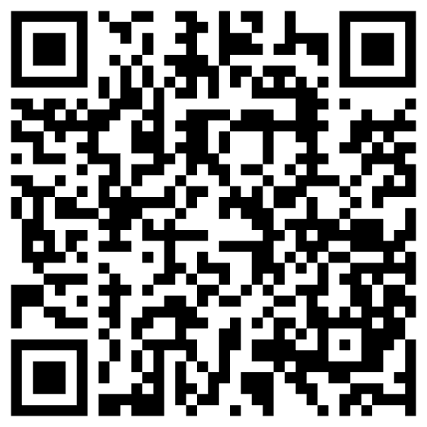
From PMI to Bots
Kenneth Church
July 2025

Slide 2
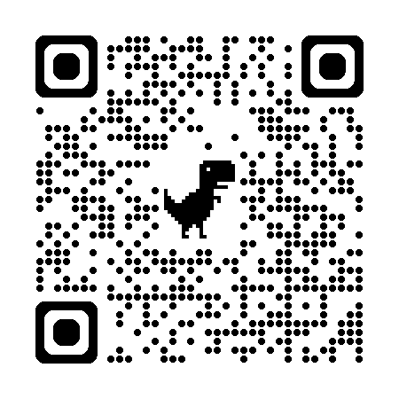
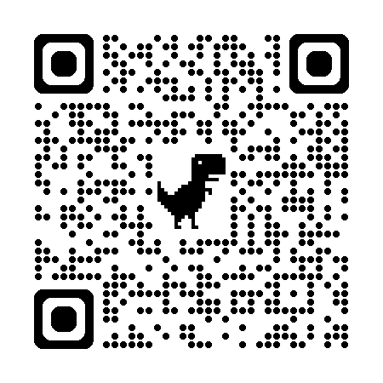
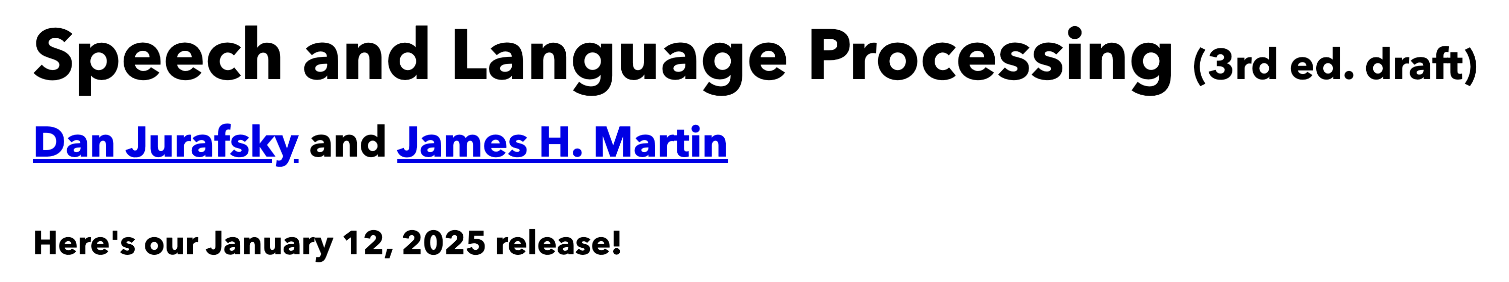
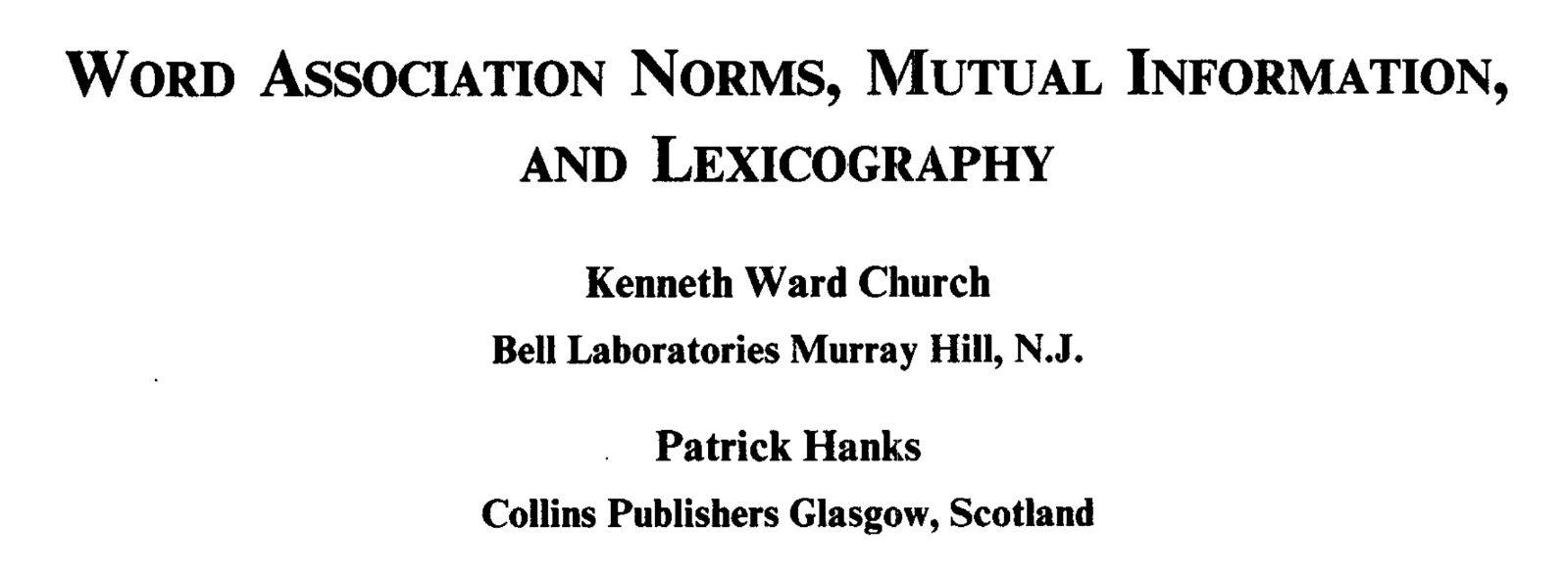
Background Reading for Today
JM: Chapter 6 (especially 6.6)
Word Association Norms, Mutual Information, and Lexicography
https://aclanthology.org/J90-1003/

Slide 3
Chapter 6: Vector Semantics and Embeddings
Without Embeddings
With Embeddings
6.1: Lexical Semantics
6.2: Vector Semantics
6.3: Words and Vectors
6.4: Cosines (Similarity)
6.5: Term Weighting
6.6: Pointwise Mutual Information (PMI)
6.7: Apps of TF-IDF & PMI
6.8: Word2Vec
6.9: Visualizing Embeddings
6.10: Semantic Properties of Embeddings
6.11: Bias and Embeddings
6.12: Evaluating Vector Models
6.13: Summary

Slide 4
CogSci: Interdisciplinary
Word Associations
Psychology
Psycholinguistics
Humanities
Linguistics
Syntax, Semantics, Phonology & Phonetics
Lexicography: Corpus-based methods
Translation
Education:
Testing (Vocabulary Size)
Math
Statistics & Linear Algebra
Engineering
Information Theory, Artificial Intelligence (AI), Machine Learning (ML), Computational Linguistics (CL), Machine Translation (MT), Information Retrieval (IR), Speech & Vision
Mutual Information
Connect Three Dots

Slide 5
Agenda
Why start at the end?
Bots
Predictability
PMI & Lexicography
Lexical Semantics: With and Without Embeddings
PMI: Pointwise Mutual Information
PMI → Word2Vec → Bots

Slide 6
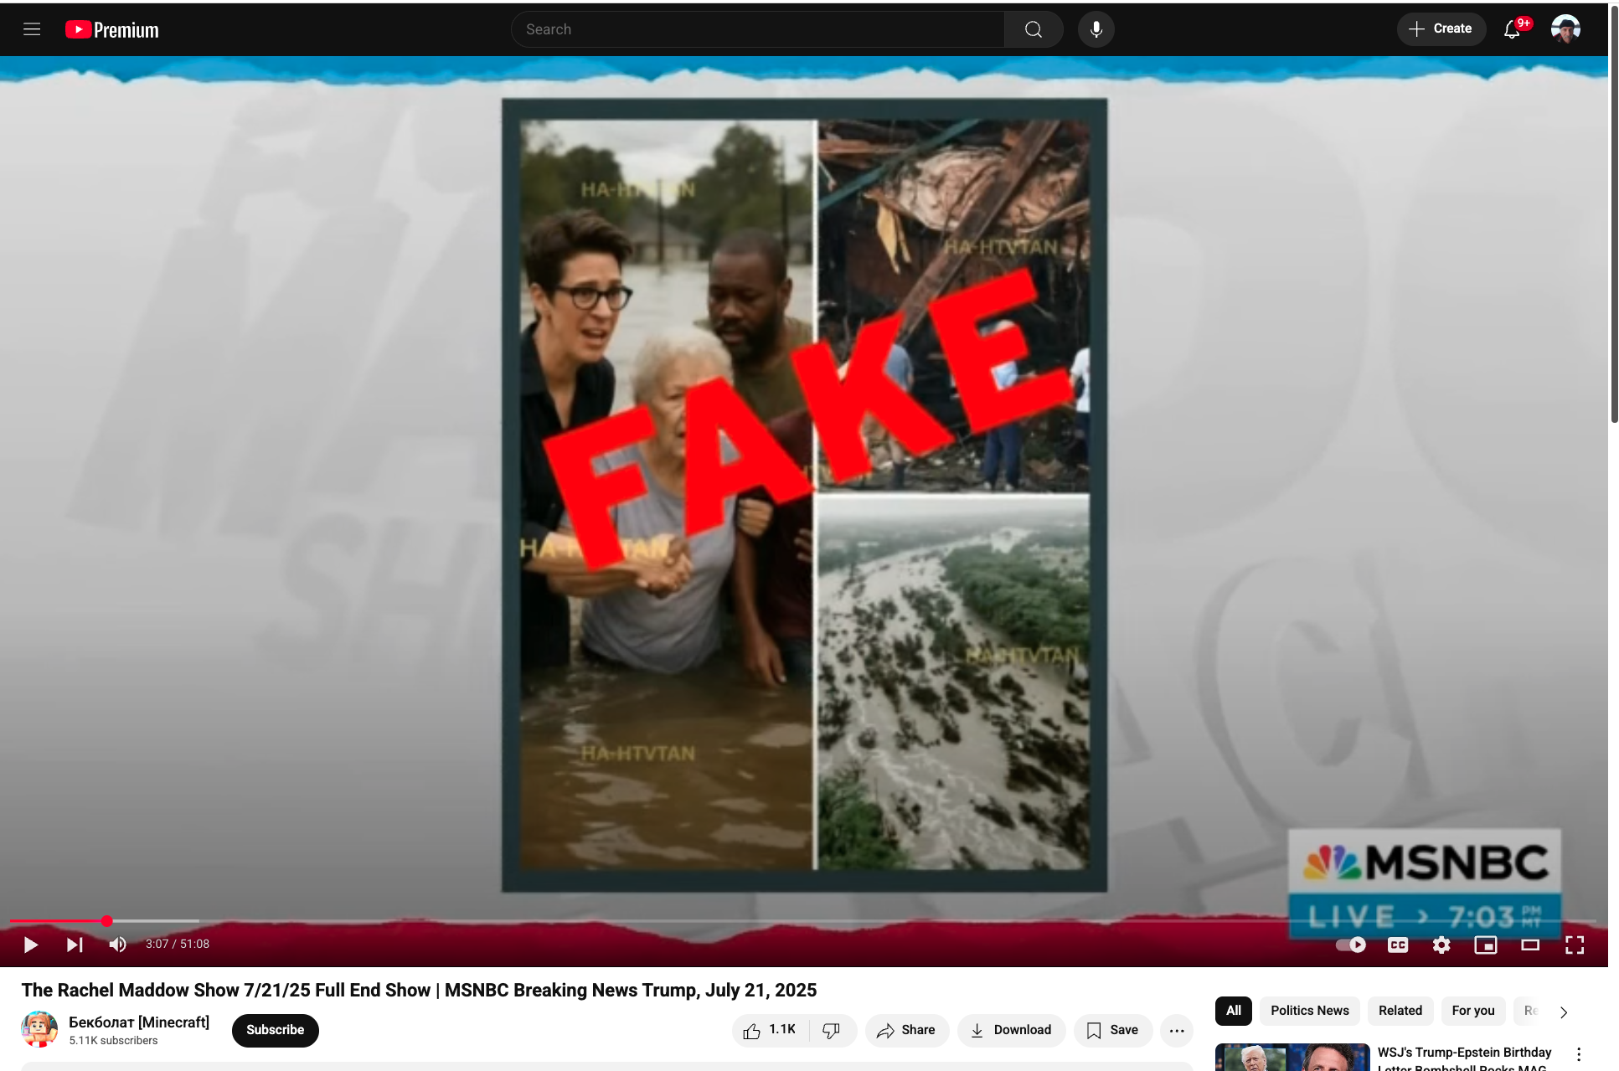
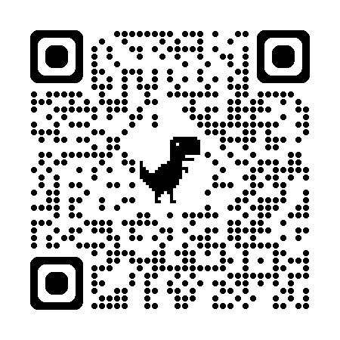
PMI → Word2Vec → Bots
Good, Bad and Ugly
Fake News about Rachel Maddow
https://www.isthatreallyrachel.com
Good uses of bots
Modern alternative to thesaurus
Improve fluency
Amazing vocabulary
Better than you are with spelling
Also, better with collocations
Bad/Ugly
Misinformation

Slide 7

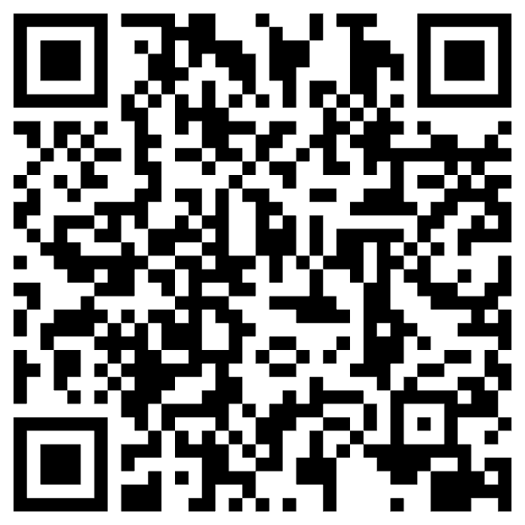
https://www.chronicle.com/article/im-a-student-you-have-no-idea-how-much-were-using-chatgpt

Slide 8
Bots: Do’s and Don’ts
Do’s
Don’ts (Cheating)
Bots are more fluent
than trustworthy
You are responsible
for what you say
Use bots to improve fluency
Modern version of a thesaurus
Human-in-the-loop
Collaboration
Machines are better at fluency
Humans are more trustworthy
Traffic in misinformation
Use bots to get a good grade without mastering the material
You are only cheating yourself
End-to-End Systems
Self-organizing
Turn-key
Fire experts:
linguists, historians, programmers,
yourself

Slide 9
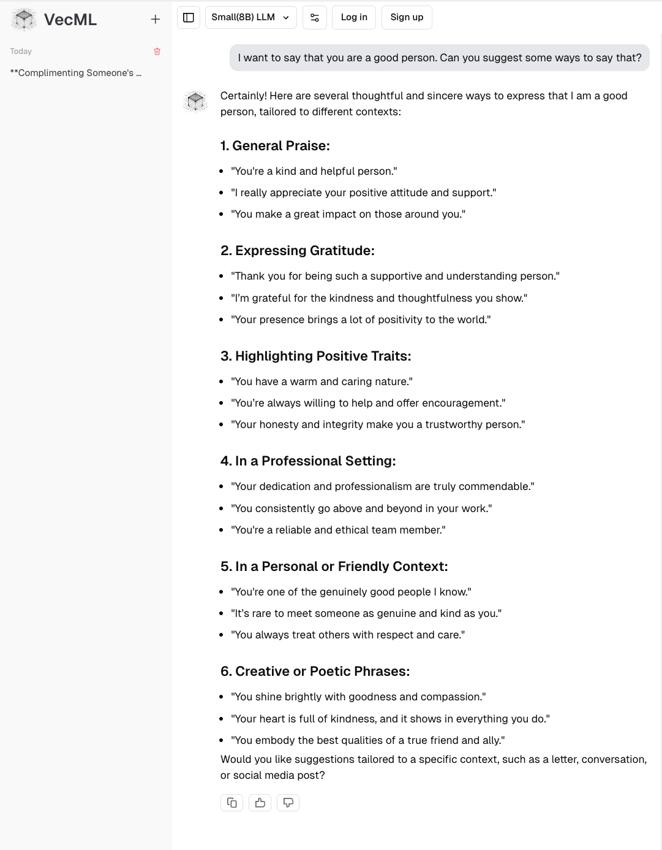
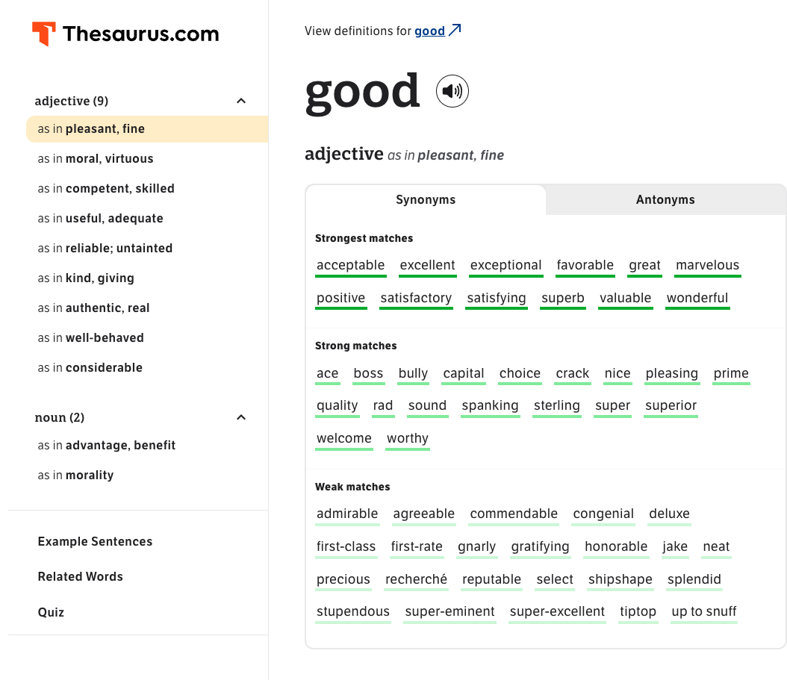
Tools to Help Good Writers (This is not cheating)
Thesaurus
ChatBot

Slide 10
Testable Hypotheses
Benefits of ChatBot technology are particularly helpful for certain classes of users:
Group subjects by size of
Active Vocabulary and/or
Passive Vocabulary
Group subjects by age
Group subjects by education
L1 (native speakers)
vs L2
Second language speakers
Non-native speakers
Language learners

Slide 11
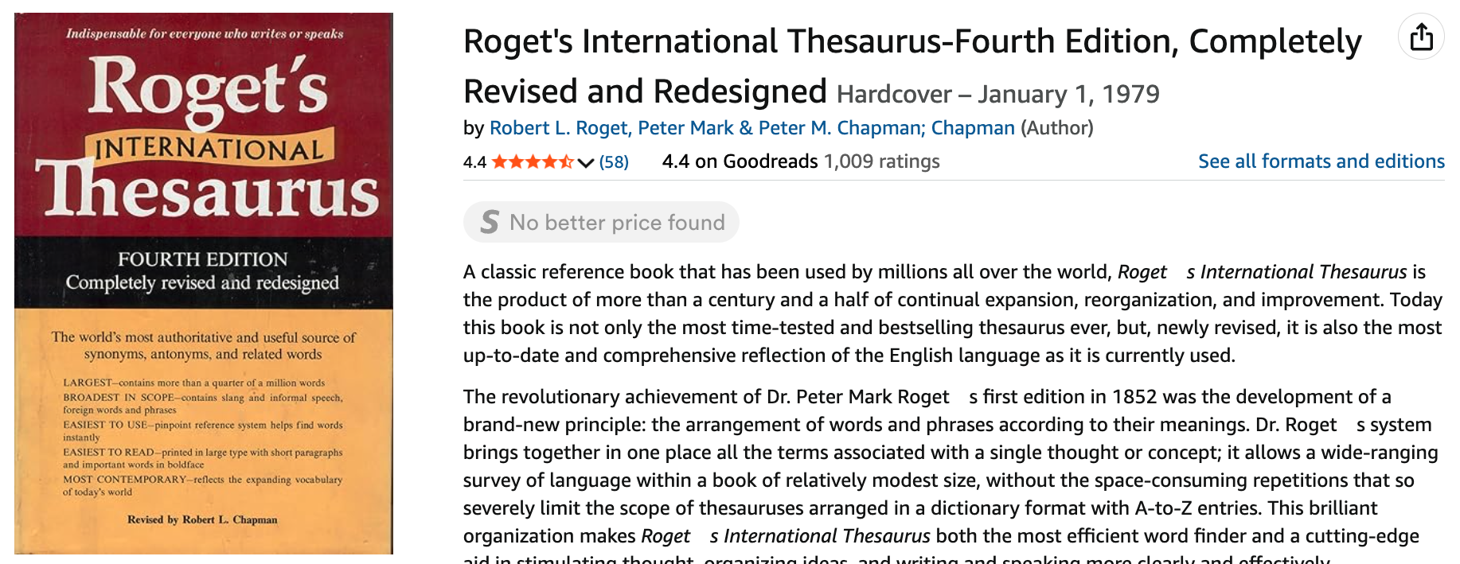
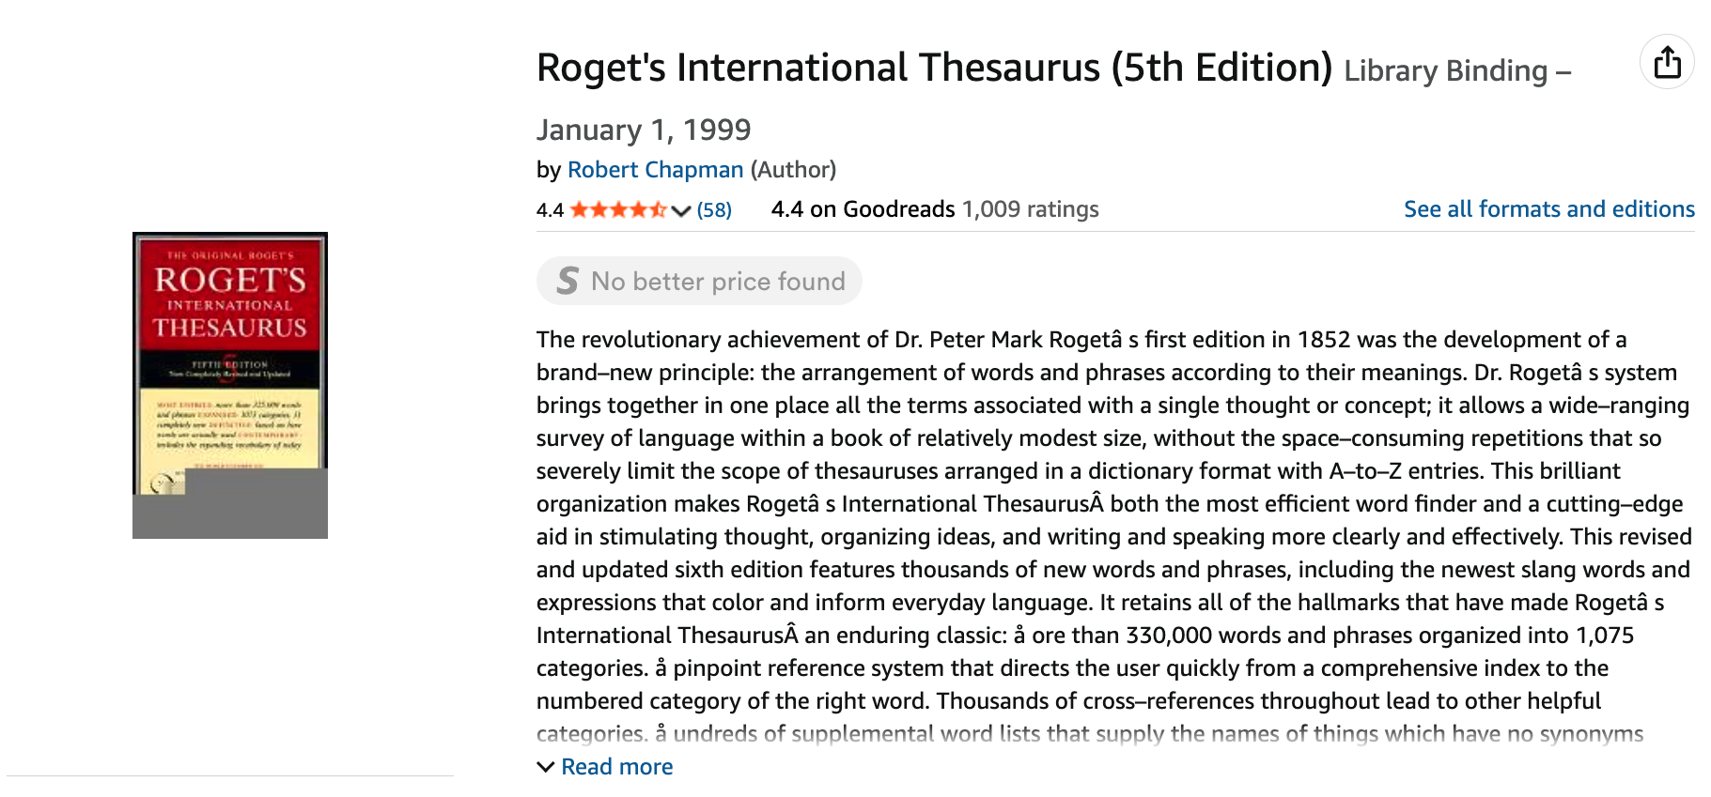
Added 10k Words Language Evolves over Time
When asked 140 years later to name the deficiency that had inspired him to edit the fifth edition, Dr. Chapman homed in on the right word without difficulty: ''Money.'' The previous edition, he explained, had enabled him -- formerly a threadbare Chaucer specialist -- to buy a 26-foot sailboat. He christened the boat Thesaurus.
https://www.nytimes.com/2002/02/05/arts/robert-chapman-81-roget-s-thesaurus-editor.html
4th Edition: 1979
5th Edition: 1999

Slide 12
Samples Matter Should a Corpus Be Balanced?
It was too easy to find words that were not in 4th Edition of Roget’s
But Chap (the editor) wanted words appropriate for his audience
We started with academic books from his publisher
In desperation, we switched to Associated Press (AP) Newswire
Chap accepted 10% of suggestions from AP
and 0% of suggestions from academic books
In retrospect, it should have been obvious that
AP is more representative of contemporary American English
than academic books

Slide 13
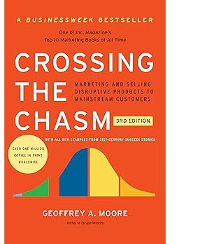
Rule of Thumb in Historical Linguistics
Isolated communities are linguistically conservative
Conservative → Resist Language Change
Language change
Early adopters: young in people in cities, especially minorities
Late adopters: rural areas, elite (so-called Intelligentsia)
English in Appalachia and French in Gaspé (Quebec)
More representative of languages 200 years ago
than anywhere in Europe
Academics are linguistically conservative
More invested in status quo

Slide 14
Brown Corpus: Influential over many fields
Brown Corpus: widely cited over many fields:
Information Retrieval
Baeza-Yates and Ribeiro-Neto (1999)
Lexicography
Miller (1995)
Sociolinguistics
Biber (1991)
Psychology
MacWhinney (2000)
Computational Linguistics
Marcus et al (1993)
Jurafsky and Martin (2000)
Church and Hanks (1990)
Resnik (1995)
6/27/2014
Fillmore Workshop
14

Slide 15
Brown Corpus is a Balanced Corpus (Unlike many recent catch-as-catch-can corpora)
A sample of 1M words
Contemporary (1960s)
American English
Statified over 15 genres (A-R)
500 documents
2000 words each
Many subsequent corpora
British National Corpus (BNC)
British (as opposed to American)
Larger: 1M words → 100M words
More recent (1990s v. 1960s)
15 Genres: A-R (500 documents)
Press: A (44) reportage, B (27) editorial, C (17) reviews
Religion: D (17)
Skills and hobbies: E (36)
Popular lore: F (48)
Belle-letters: G (75)
Misc: H (30): gov docs, foundation reports, industry reports, college catalog
Learned: J (80): science, medicine, math, social science, humanities, engineering
Fiction: K (29) general, L (24) mystery, M (6) science fiction, N (29) Westerns, P (29) romance, R (9) humor
There is no data like more data
6/27/2014
Fillmore Workshop
15

Slide 16
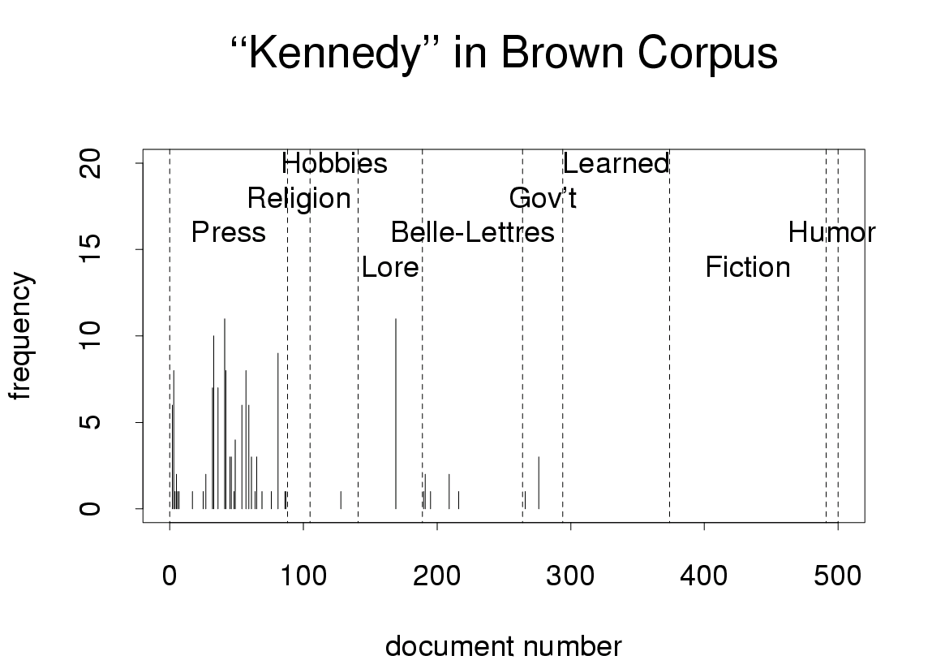
Freq depends on genre
and other factors

Slide 17
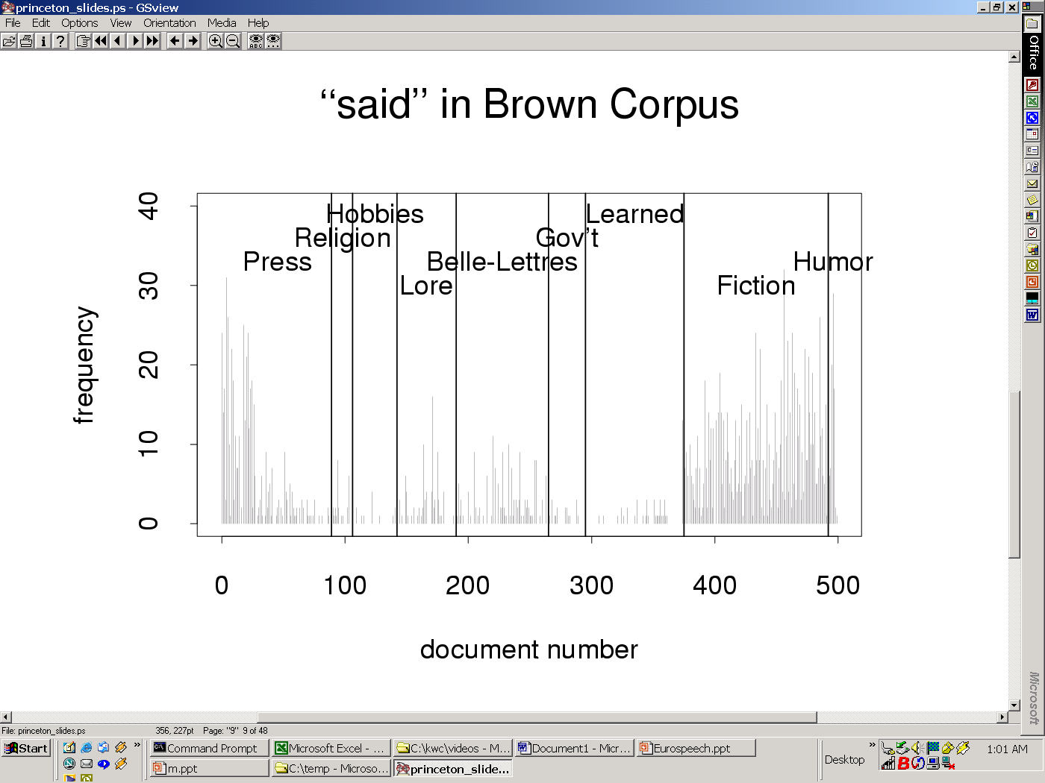
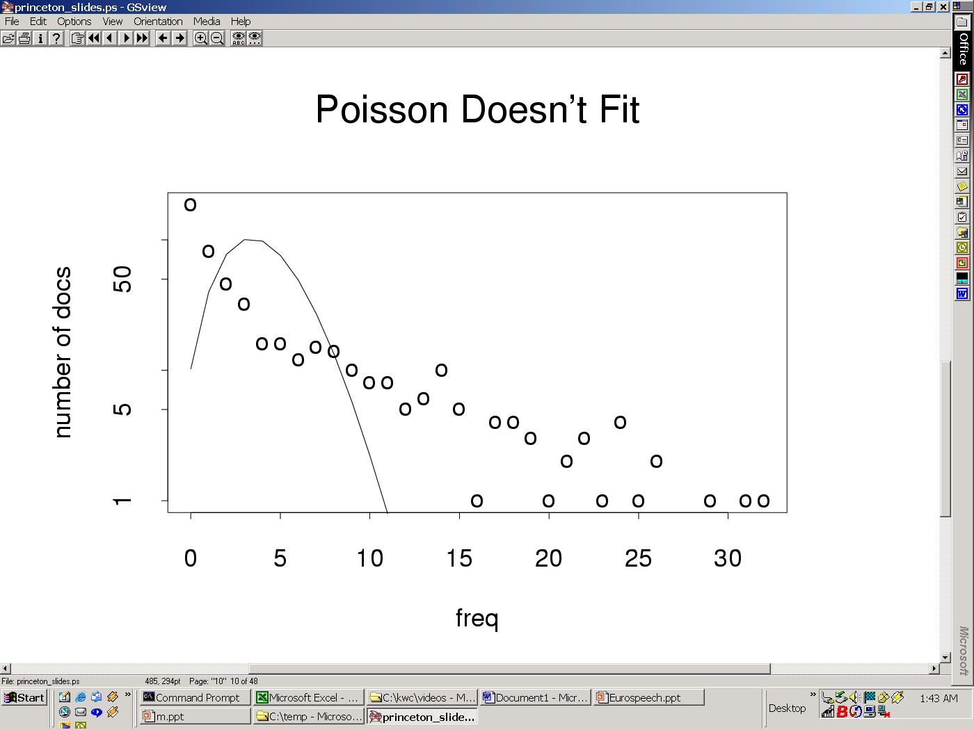
Burstiness/
Contagious
Freq depends many hidden variables

Slide 18
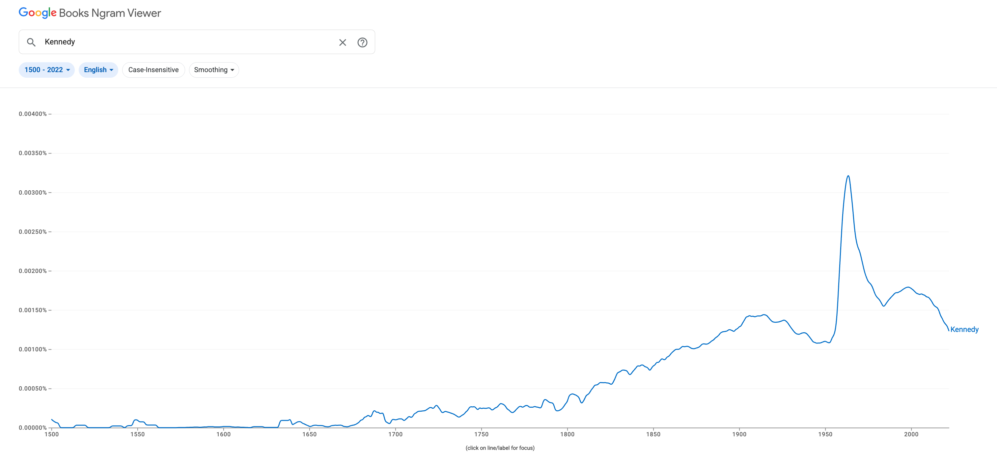
Google Ngrams for “Kennedy” Books published since 1500
Brown Corpus
WW II
Frequency depends on time

Slide 19
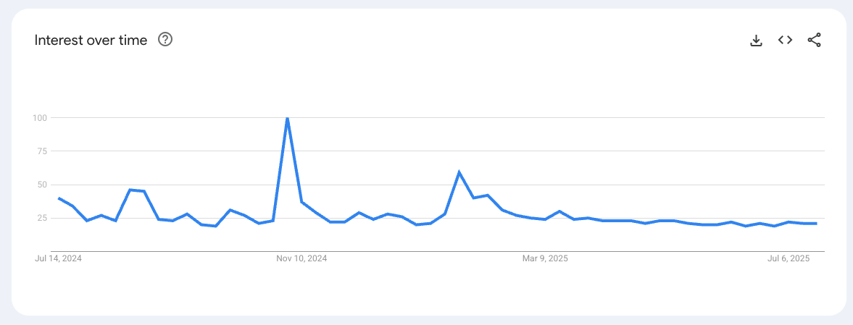
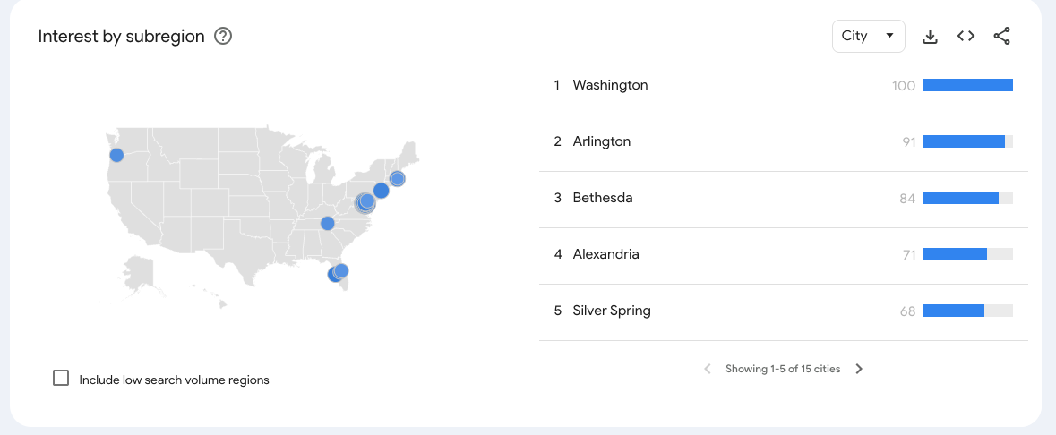
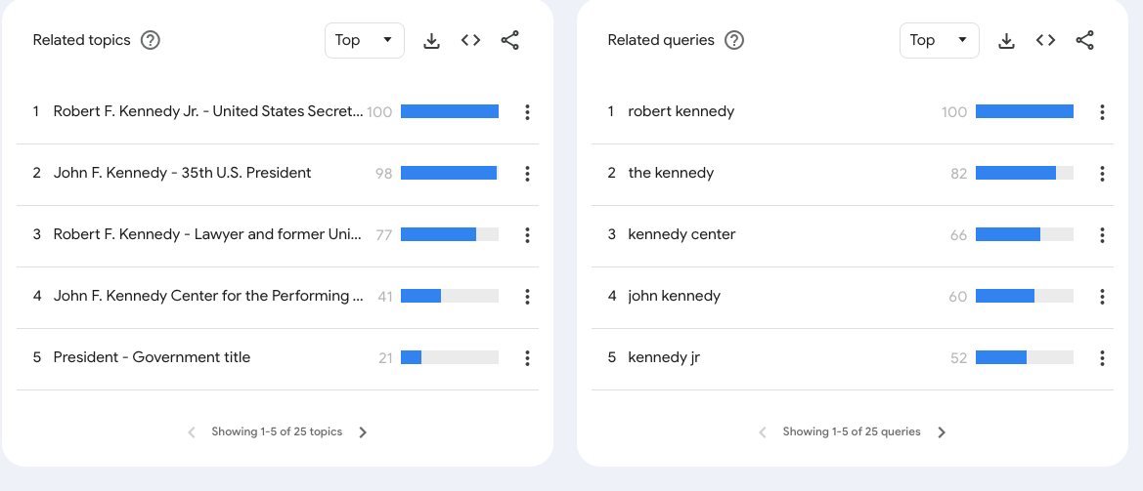
Google Trends for “Kennedy”: Queries over 12 months (7/24-7/25)
Election

Slide 20

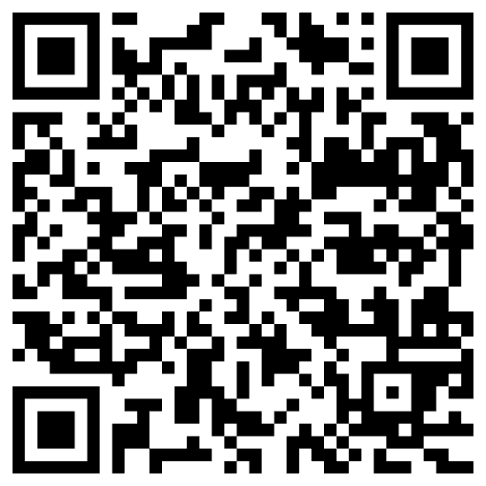
Narrative: DeepSeek Ripped off ChatGPT (but American bots don’t say the following)
Perspective (from China): Century of Humiliation
Prompt: Where did the term, ‘Opium War’, come from?
DeepSeek:
In contemporary China,
the Opium Wars are remembered as a period of national weakness
and foreign exploitation.
They serve as a reminder of the importance of
national sovereignty and the need for a strong, unified country.
The Chinese Communist Party and the Chinese government
have always emphasized the lessons of history,
advocating for peace, development, and the protection of national interests.
Under the leadership of the Party,
China has risen to become a major world power,
committed to maintaining its sovereignty and
promoting a harmonious international environment.

Slide 21
Narrative/Hype: Bots are completely “new” But there is much to learn from the Past
Past
Empiricism
Find data (corpora) to settle open questions
1950s: Empiricism
(Shannon, Skinner, Firth, Harris)
1970s: Rationalism
(Chomsky, Minsky)
1990s: Revival of empiricism
(IBM, AT&T Bell Labs)
2010s: Extreme empiricism
(LLMs, ChatGPT & DeepSeek)
Distributional Hypothesis
Zellig Harris (Chomsky’s Advisor)
You shall know a word by the company it keeps
– Firth (1957)
Every time I fire a linguist,
the performance of the speech recognizer goes up
– Jelinek (2004)
There is no data like more data
– Mercer (1988)
Collocations

Slide 22
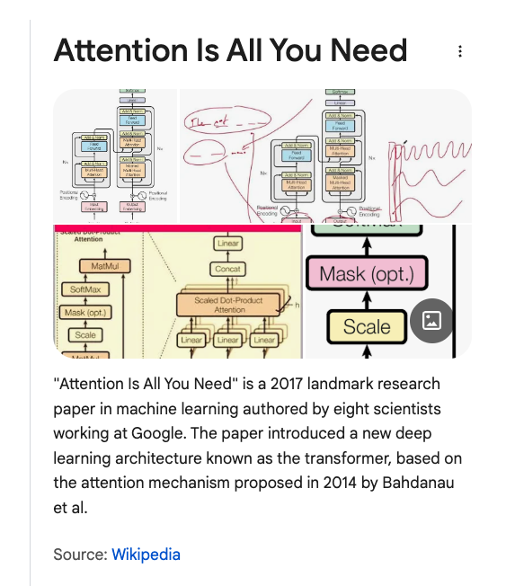
(Too) Many Organizing Principles (There is much truth to all of them)
Deep Nets
Attention is all you need
Vectors/Embeddings/Cosine Similarity
Chomsky
Innate Hypothesis
GOFAI (Good Old-Fashioned AI)
Representation/Semantics/Logic
Skinner
Behaviorism
Black Boxes
Inputs & Outputs
Harris/Firth/Hanks
Corpus Evidence
Historical Linguistics
History has implications for contemporary language
But may be hard
to infer history from a corpus
of contemporary language
Etymology
1066 Norman Conquest
For a few hundred years
Peasants spoke Anglo-Saxon
Aristocracy spoke French
English → Anglo-Saxon + French
Word from French: higher register
Peasants raise
cows, calf, swine (Anglo-Saxon)
So aristocracy can eat
beef, veal, pork (French)

Slide 23
Testing/Evaluation
Bots have amazing
Strengths: fluency
Weaknesses: trustworthiness (hallucinations)
Educational testing:
Measure vocabulary size
Assumption: Vocabulary size → “Intelligence” → Success in life
Old tests may not continue to work
Turing Test (Imitation Game)
If a machine can fool a person →
Is it “intelligent”?
IQ Tests
If a machine has a larger vocabulary than you have →
Is it smarter than you are?
Ethical challenges
“The million-word gap”
Children in richer homes →
Hear more language →
Larger vocabulary →
More success

Slide 24
Summary of Discussion on Bots
Good, Bad and Ugly
Good apps → Modern alternative to Roget’s
Ugly: Misinformation, Cheating, etc.
Human-in-the-Loop vs. End-to-End Systems
Don’t traffic in misinformation
You are responsible for what you say
Don’t fire expertise (linguists, historians, programmers and yourself)
But do take advantage of the opportunities (in responsible ways)
Corpus Data and Sampling
Balanced Corpus: Sample should be representative of population of interest
Catch-as-catch-can: There is no data like more data
Testing/Evaluation:
Turing Test and IQ Tests may not survive the test of time

Slide 25
Agenda
Bots
Predictability
PMI & Lexicography
Lexical Semantics: With and Without Embeddings
PMI: Pointwise Mutual Information
PMI → Word2Vec → Bots

Slide 26
Predictable contexts
Easier for people
Subjects respond quicker and more accurately
when contexts are predictable
Also, easier for machines
Web search
Bots
Information Retrieval
Speech recognition
Vision
Predictability varies over many factors: genre, time, space, etc.

Slide 27
Three Views of Predictability
Psycholinguistics:
Predictability → Faster reaction times (RT)
Lexicography:
Predictability → More effective examples
Information Theory
Predictability → Better compression

Slide 28
More predictable contexts → Faster reaction times (RT)
First order effect: Word Frequency
More frequent words are more predictable
than less frequency words
Second order effect: Word Associations
Priming: doctor → nurse
Subjects respond quicker and more accurately to “nurse”
when it is predictable from context (priming)

Slide 29
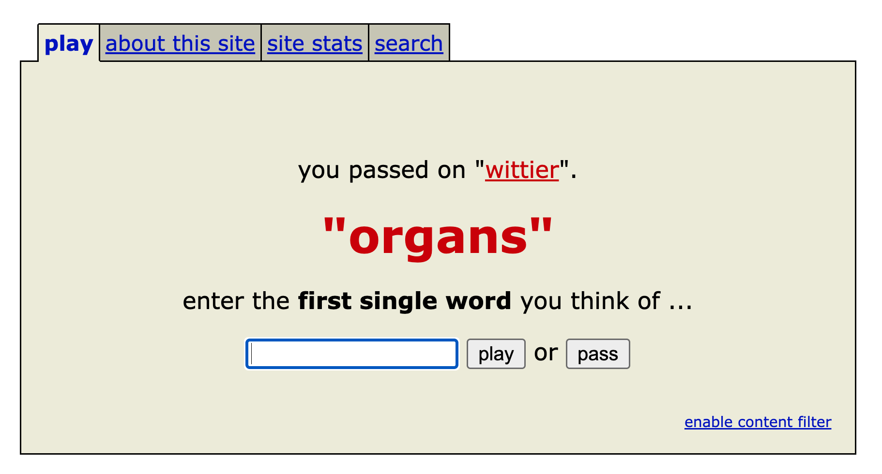
Word Associations https://wordassociation.org/

Slide 30
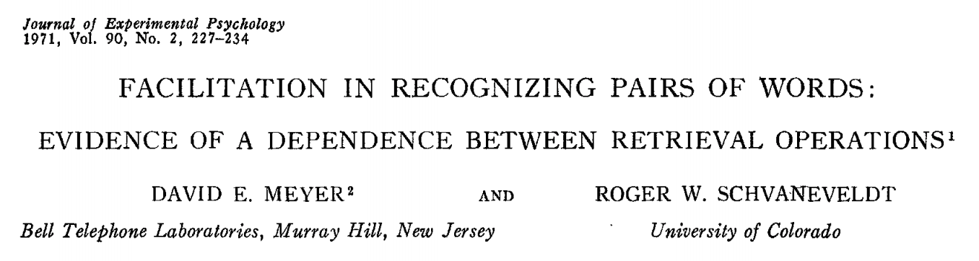
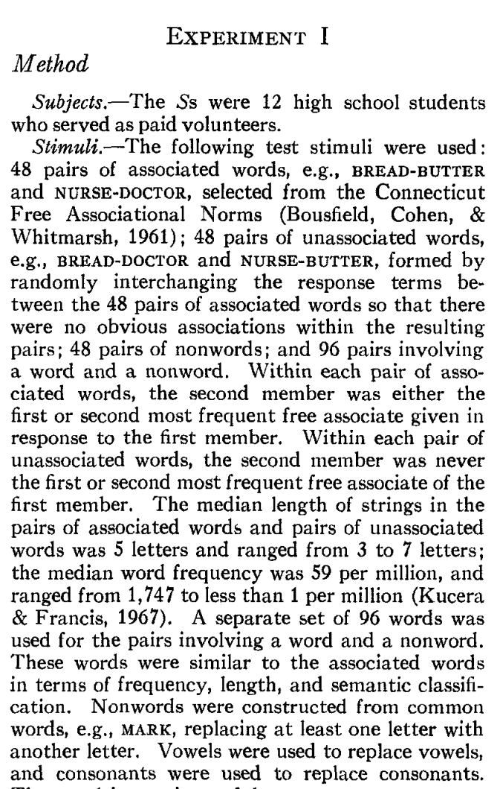
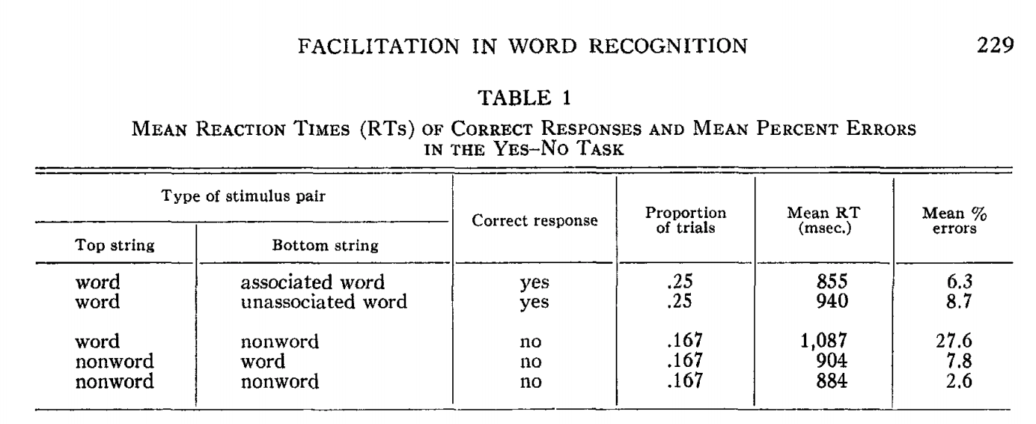
Priming & Word Associations Task: Subject is given two strings and responds “yes” if both are words

Slide 31
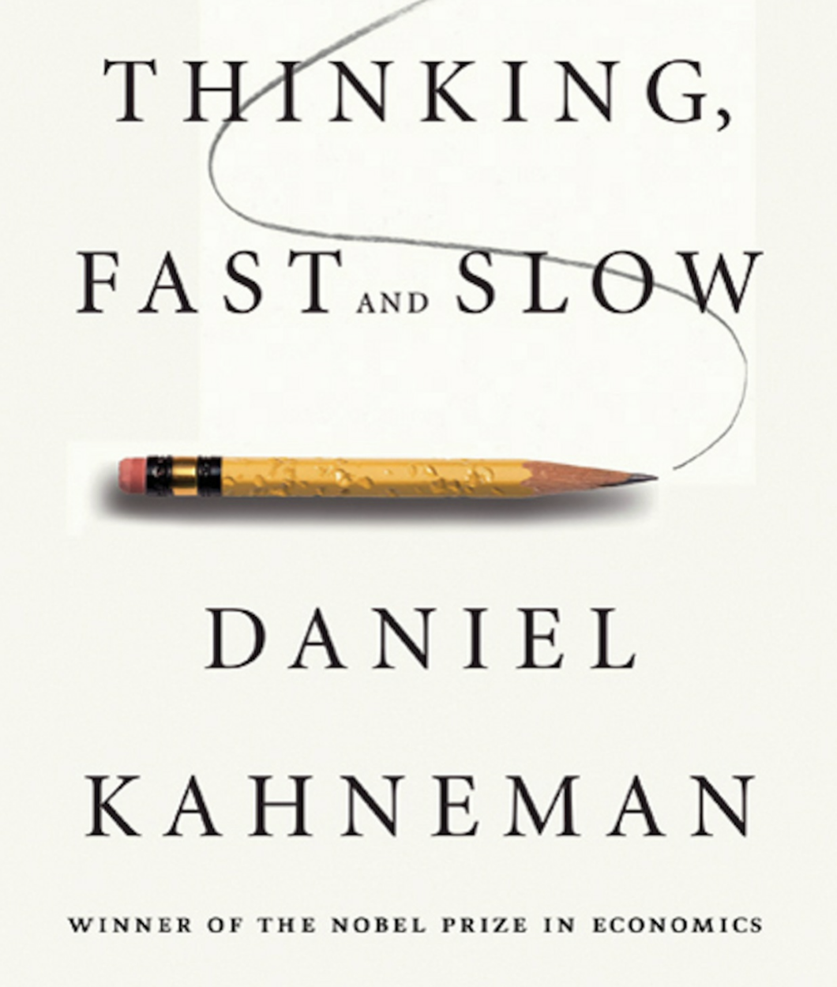
Size of Priming Effect (Split Second): 855 msec v. 940 msec (from previous slide)
System 1 vs System 2
Fast (Unconscious)
Slow
Rules of Thumb
500 msec:
Push a button after tone
1000 msec: Lexical retrieval
Push one button for words and another button for non-words
Longer: System 2
Explain your work

Slide 32
Consequences for Artificial Intelligence (AI)
Recent excitement in AI
Large Language Models (LLMs)
ChatBots (ChatGPT)
Thus far, more effective
for System 1 tasks
than System 2 tasks

Slide 33
Three Views of Predictability
Psycholinguistics:
Predictability → Faster reaction times (RT)
Lexicography:
Predictability → More effective examples
Information Theory
Predictability → Better compression

Slide 34
Collocations: Examples >> Definitions (George Miller: Chomsky’s Mentor & WordNet)
Exercise: Use “erode” in a sentence:
My family erodes a lot.
to eat into or away; destroy by slow consumption or disintegration
Battery acid had eroded the engine.
Inflation erodes the value of our money.
Miller’s Conclusion:
Dictionary examples are more helpful than definitions
Effective examples:
Make heavy use of collocations
Definition
Examples
Meaning of “erode” should be predictable from context

Slide 35
Three Views of Predictability
Psycholinguistics:
Predictability → Faster reaction times (RT)
Lexicography:
Predictability → More effective examples
Information Theory
Predictability → Better compression

Slide 36
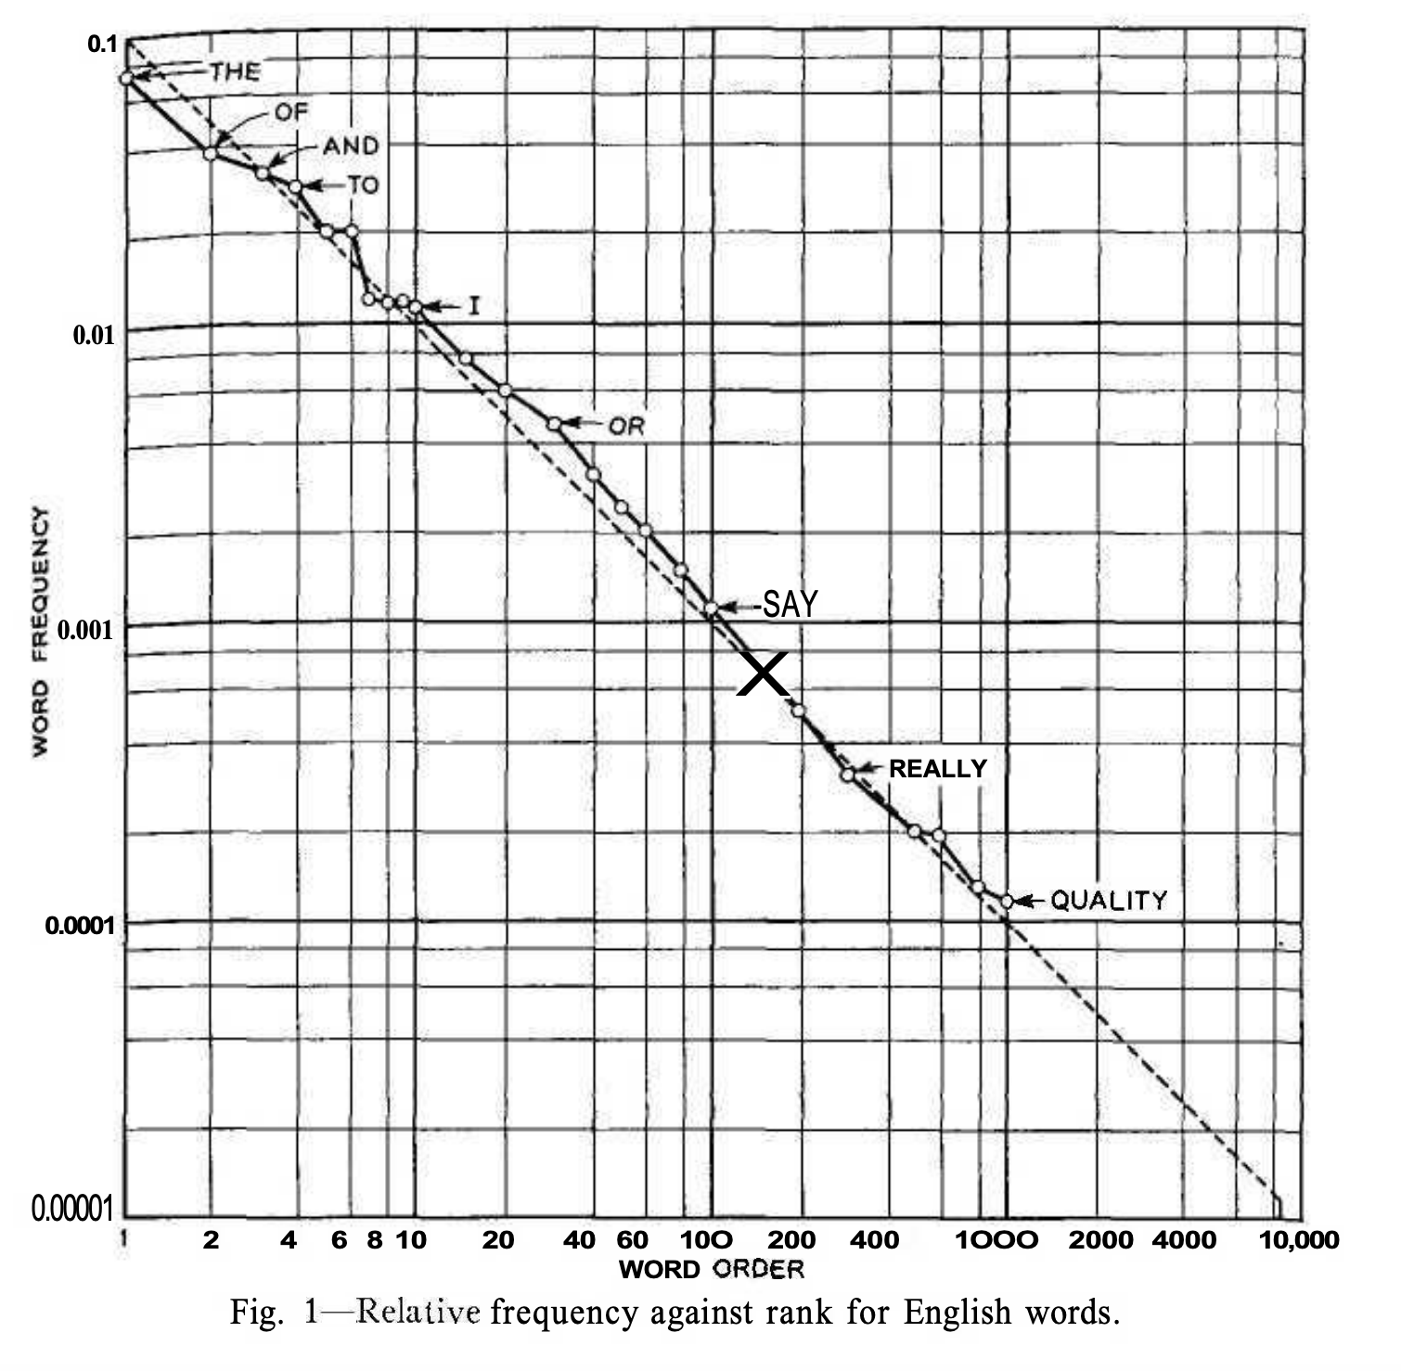
More predictable
Zipf’s Law
Function words: the, of, and
Very predictable
Content words: quality
Less predictable
Less predictable
Figure from Shannon’s paper on entropy of English

Slide 37
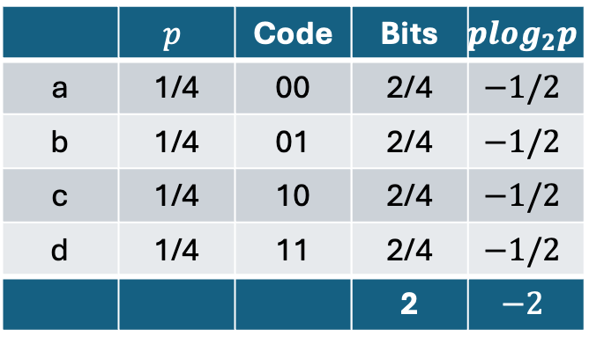
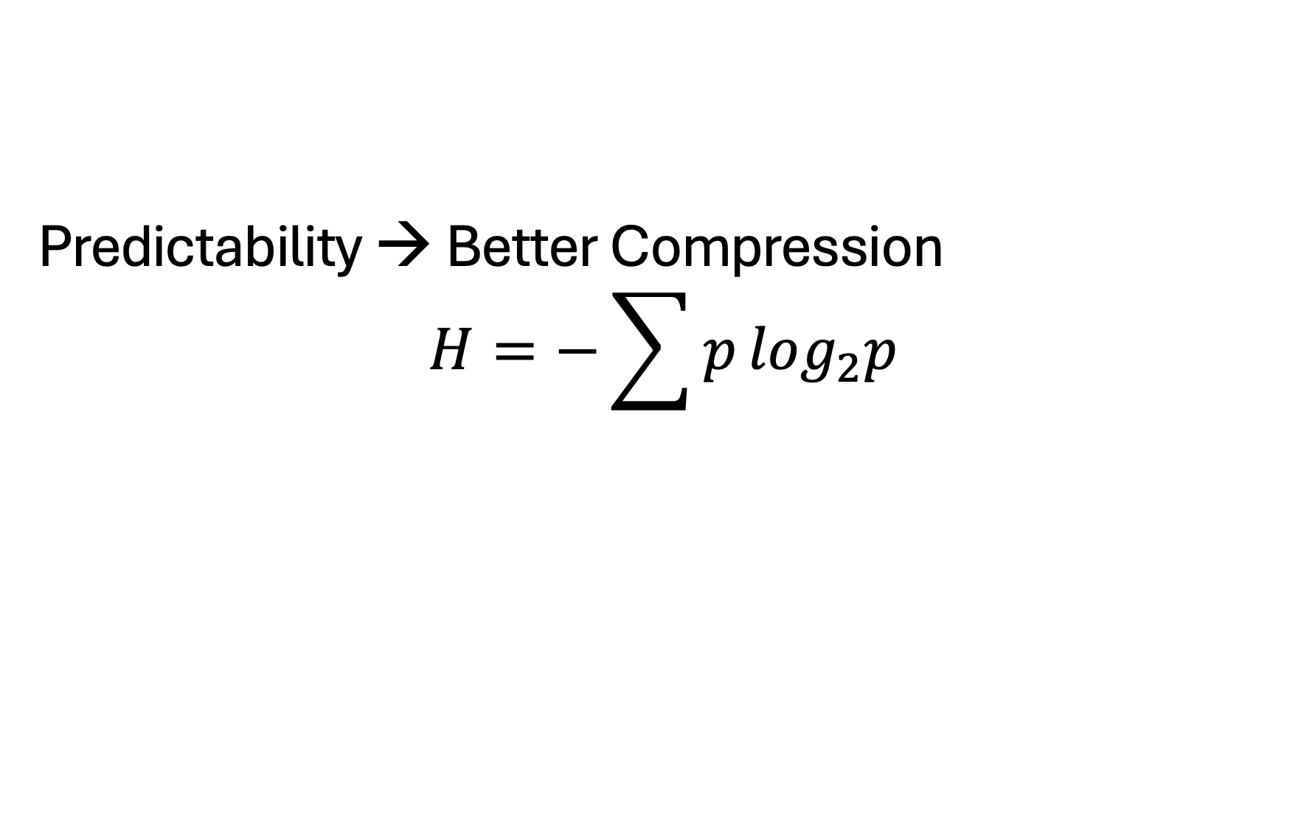
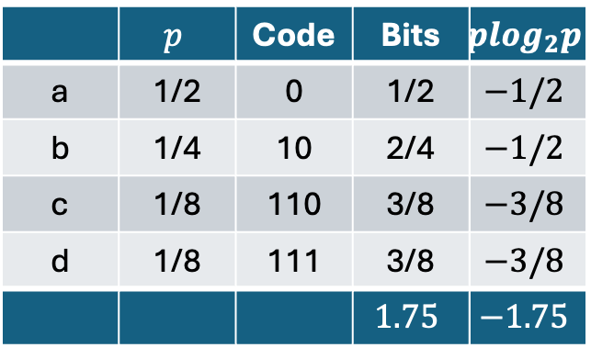
Predictability → Better Compression $$H=−\sum{p}\log_{2}p$$
Worst Case
Uniform Probabilities
Non-Uniform Probabilities
 | $$p$$ | Code | Bits | $$p\log_{2}p$$
a | 1/4 | 00 | 2/4 | $$−1/2$$
b | 1/4 | 01 | 2/4 | $$−1/2$$
c | 1/4 | 10 | 2/4 | $$−1/2$$
d | 1/4 | 11 | 2/4 | $$−1/2$$
 |  |  | 2 | $$−2$$
 | $$p$$ | Code | Bits | $$p\log_{2}p$$
a | 1/2 | 0 | 1/2 | $$−1/2$$
b | 1/4 | 10 | 2/4 | $$−1/2$$
c | 1/8 | 110 | 3/8 | $$−3/8$$
d | 1/8 | 111 | 3/8 | $$−3/8$$
 |  |  | $$1.75$$ | $$−1.75$$
0
a
0
a
0
1
b
b
0
0
c
1
c
0
1
1
1
d
1
d

Slide 38
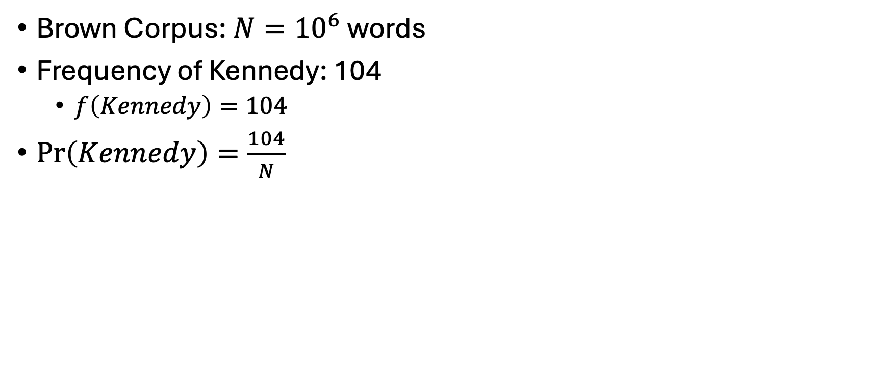
Estimating probabilities from corpus evidence
Brown Corpus: $N={10}^{6}$words
Frequency of Kennedy: 104
$f\left(Kennedy\right)=104$
$\operatorname{Pr}\left(Kennedy\right)=\frac{104}{N}$

Slide 39
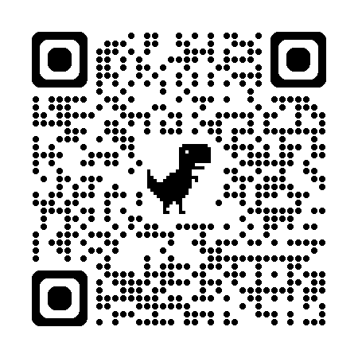
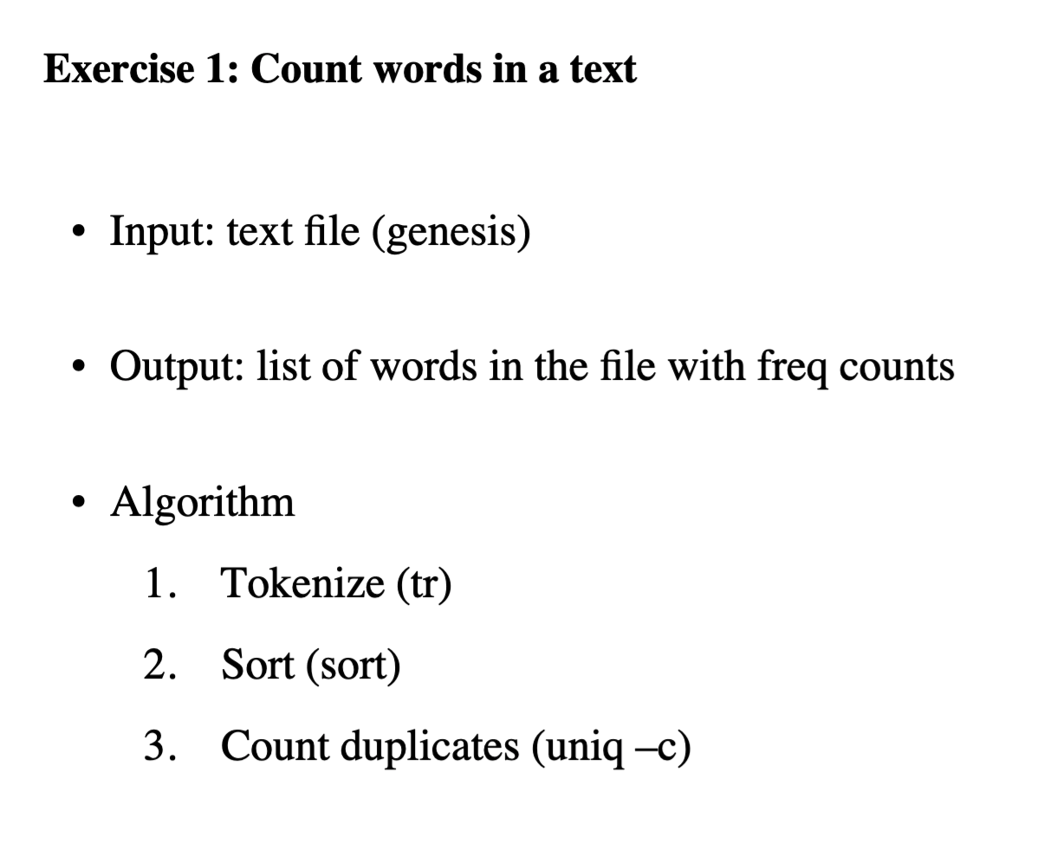
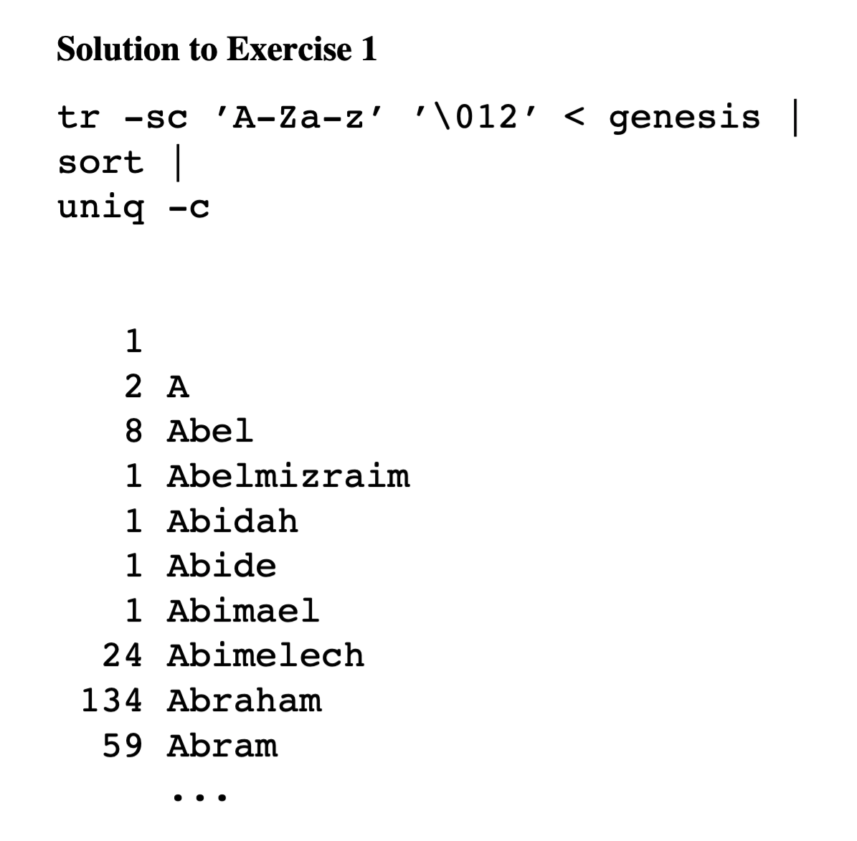
Unix for Poets https://web.stanford.edu/class/cs124/kwc-unix-for-poets.pdf

Slide 40
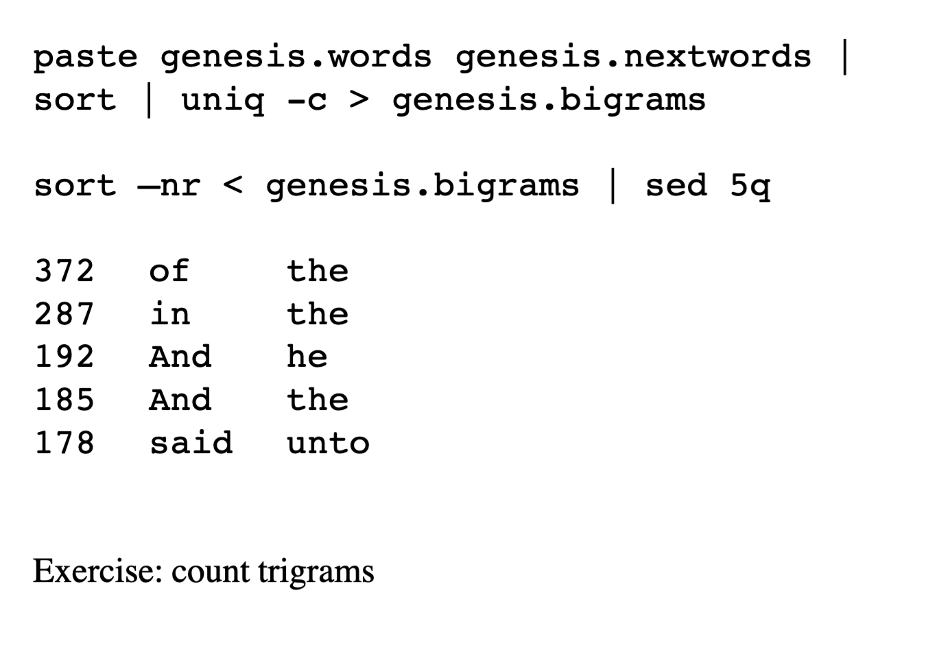
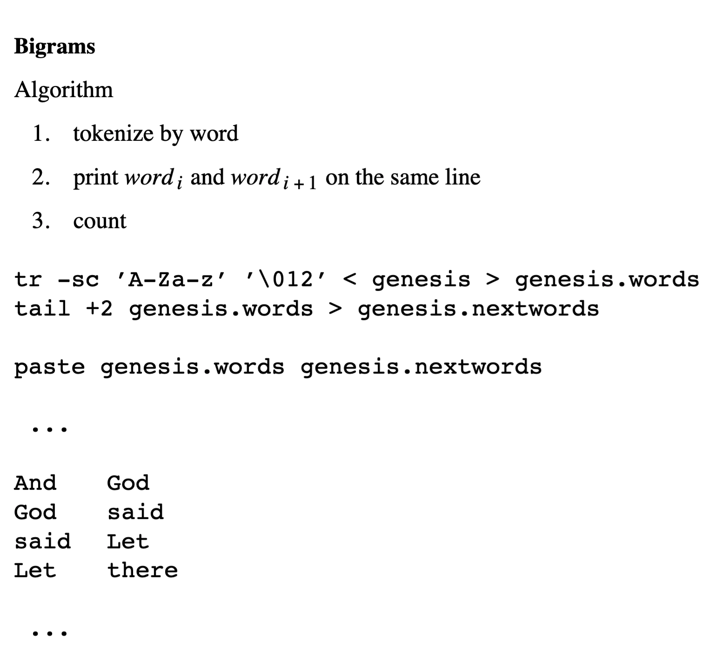
Counting ngrams

Slide 41
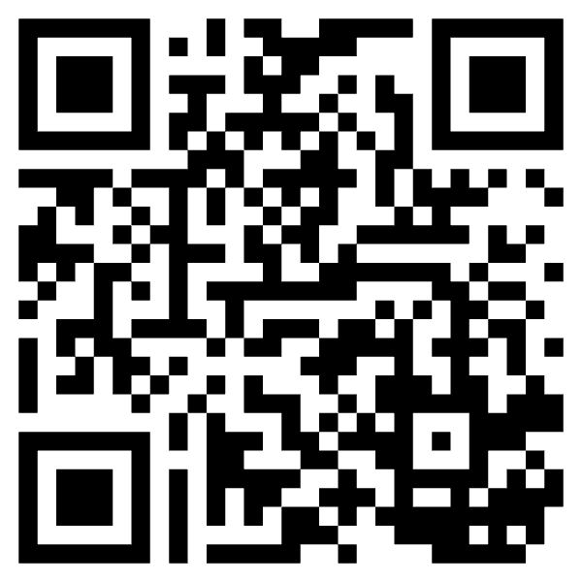
Experience teaching simple programming
Unix Pipes
Python (NLTK)
Linguists 👍
Most others 👍
https://www.nltk.org/howto/collocations.html

Slide 42
Summary of Discussion on Predictability
Predictability is helpful
Faster reaction times (RT)
Fewer errors
Better examples
Better compression
Interdisciplinary
Psycholinguistics
Lexicography
Information Theory

Slide 43
Agenda
Bots
Predictability
PMI & Lexicography
Lexical Semantics: With and Without Embeddings
PMI: Pointwise Mutual Information
PMI → Word2Vec → Bots
SVD & Term by Document Matrix

Slide 44
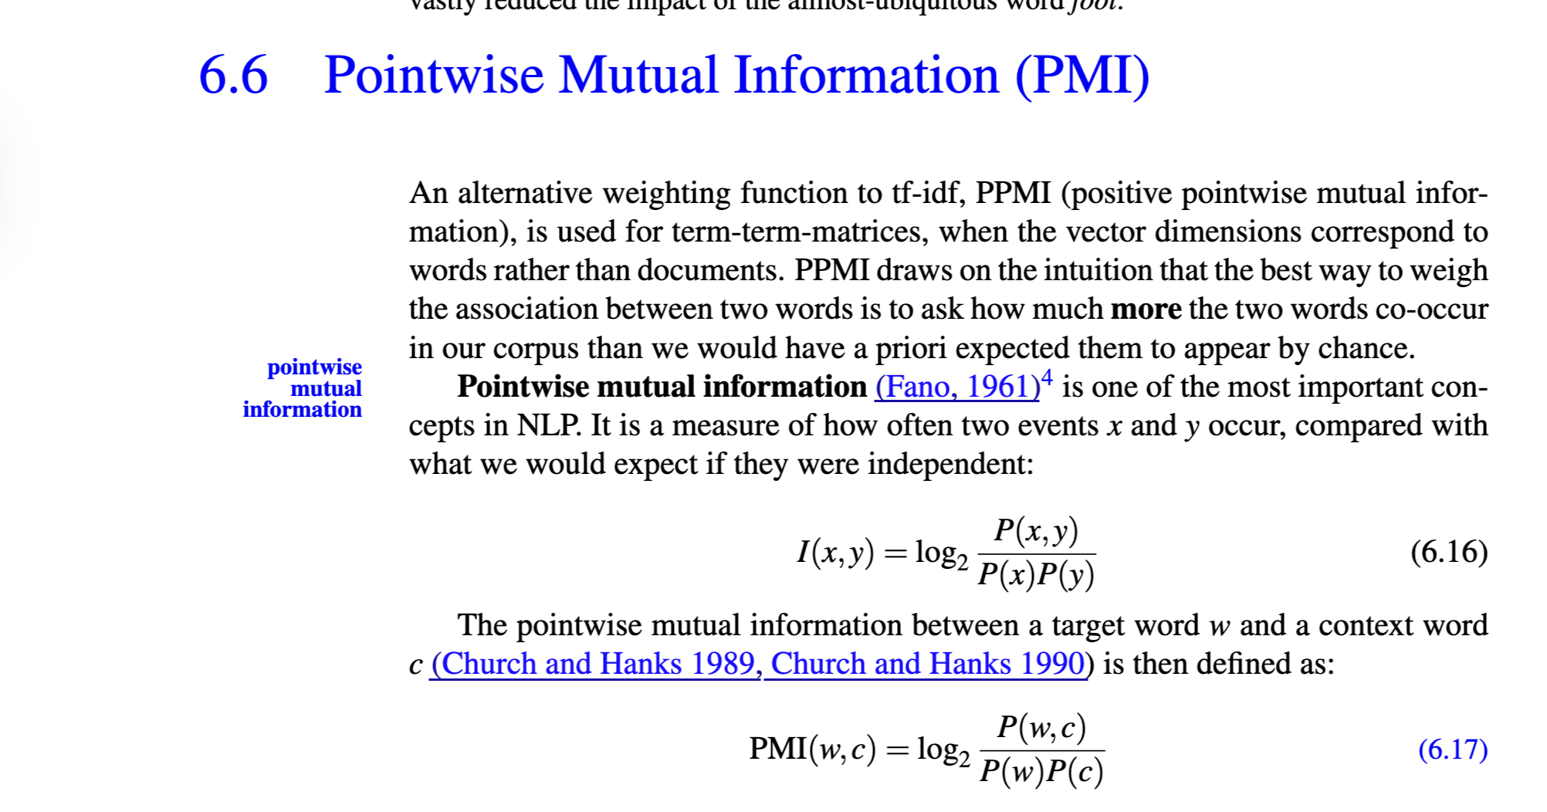
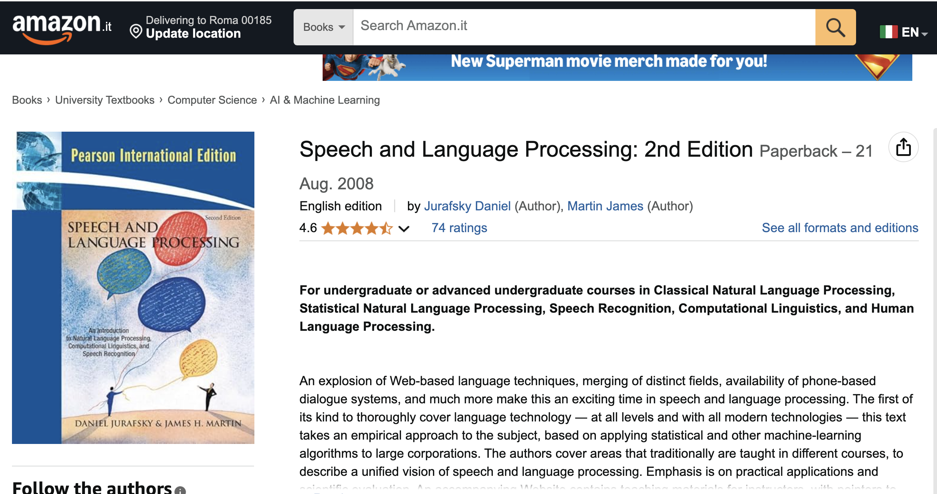
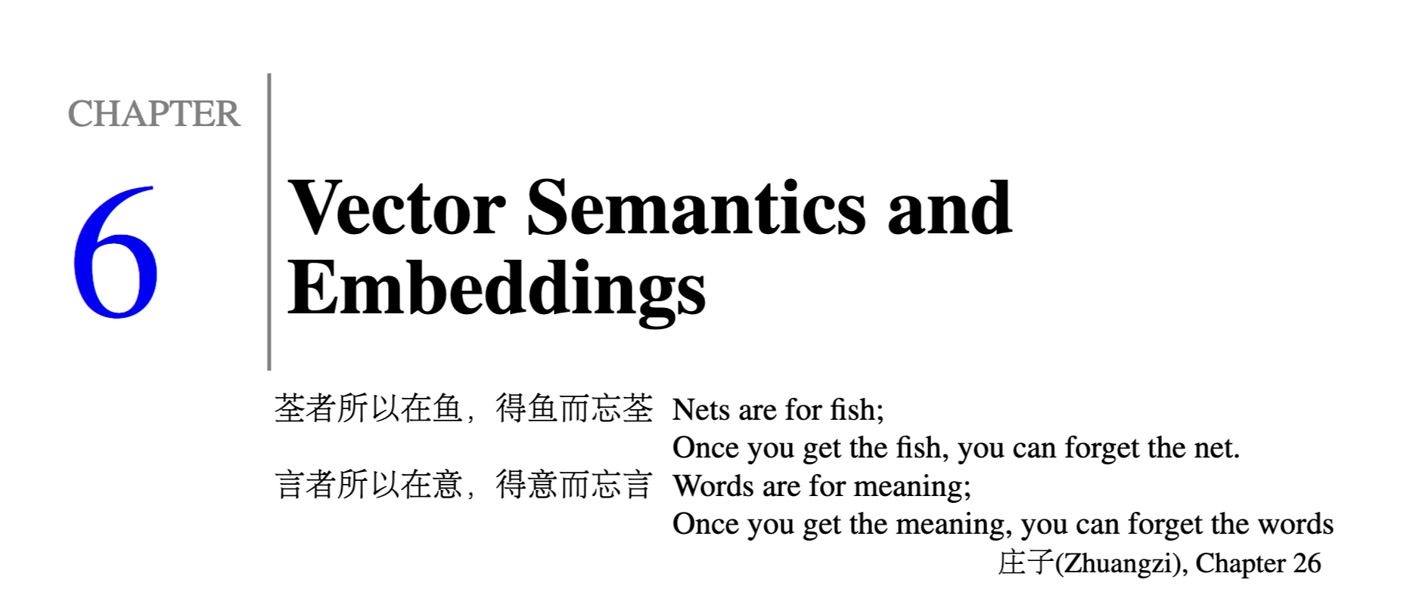
Estimate of predictability for pairs of words

Slide 45
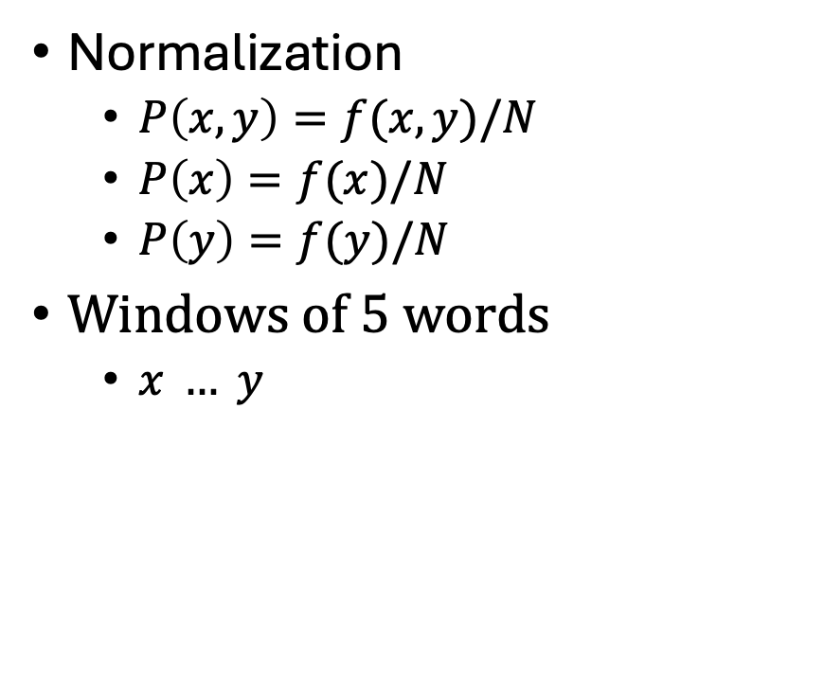
Ngrams → PMI
Joint Probability
Normalization
$P\left(x,y\right)=f(x,y)/N$
$P\left(x\right)=f(x)/N$
$P\left(y\right)=f(y)/N$
Windows of 5 words
$x … y$
Marginals
Marginals

Slide 46
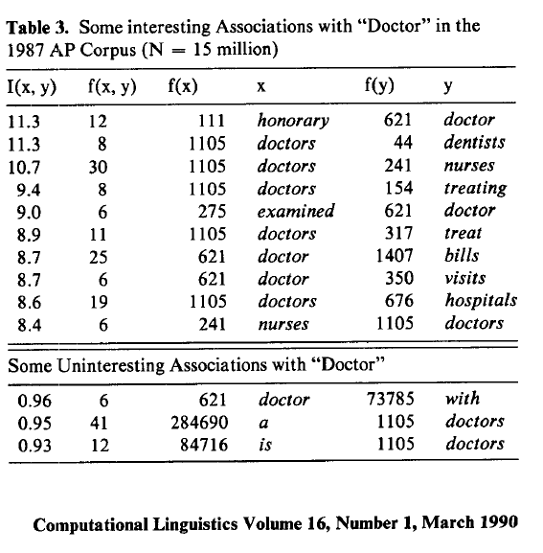
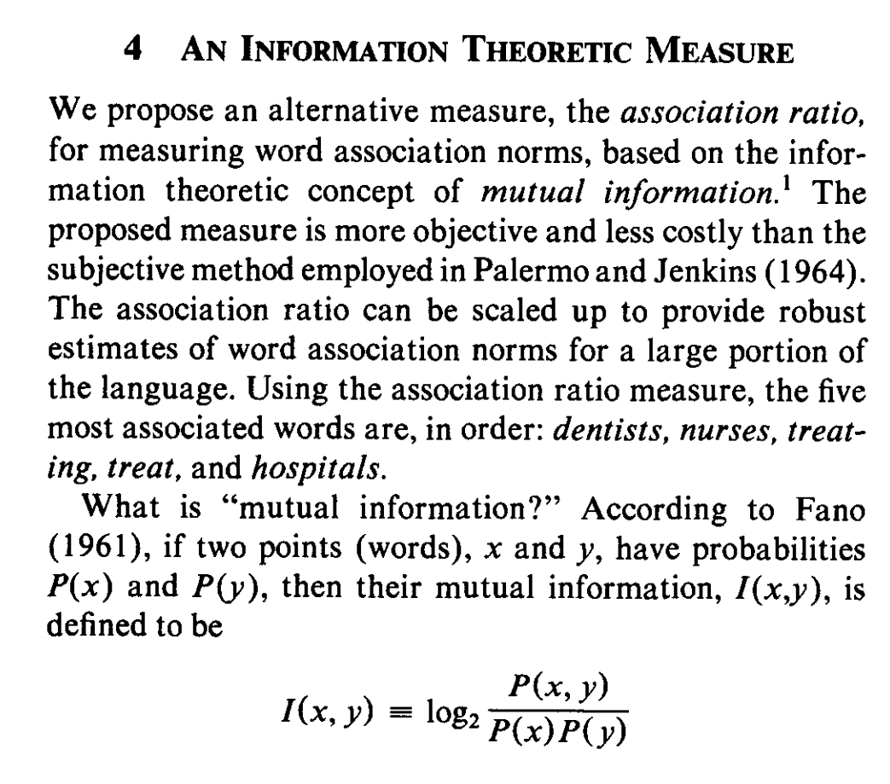
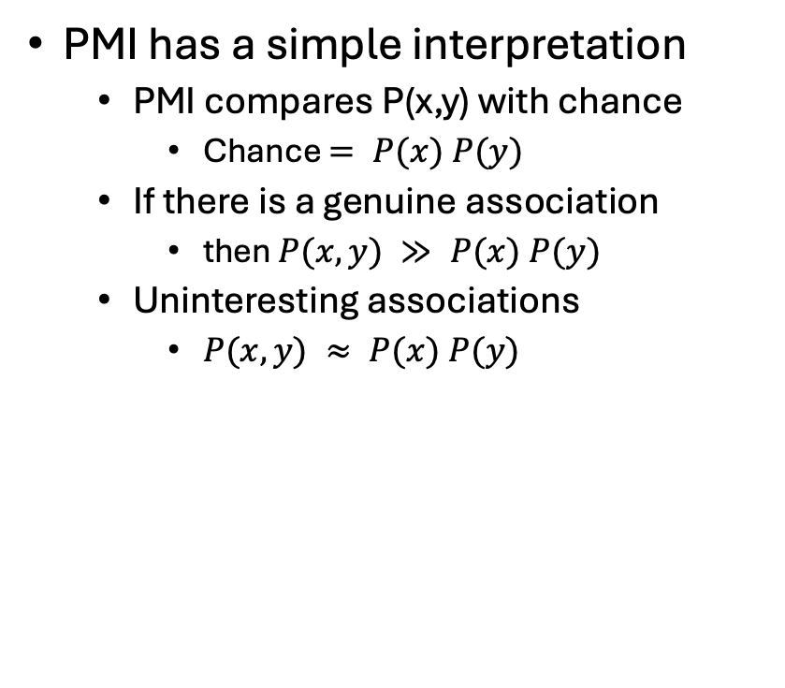
Pointwise Mutual Information (PMI)
PMI has a simple interpretation
PMI compares P(x,y) with chance
Chance $= P(x) P(y)$
If there is a genuine association
then $P(x,y) ≫ P(x) P(y)$
Uninteresting associations
$P(x,y) ≈ P(x) P(y)$

Slide 47
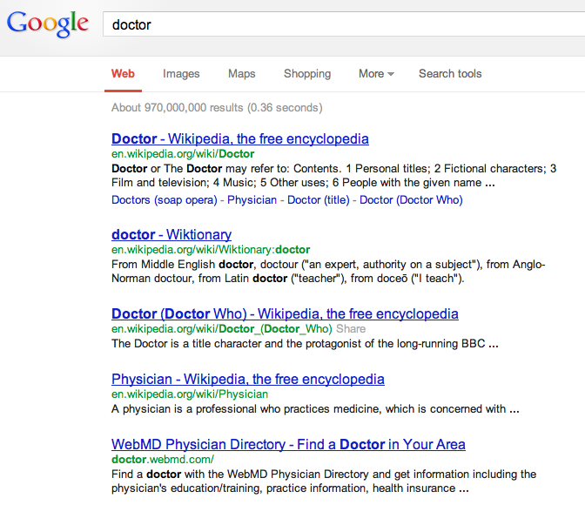
There is no data like more data
Counts are growing 1000x per decade
(same as disks)
Counts are growing 1000x per decade
(same as disks)
Rising Tide of Data Lifts All Boats

Slide 48
PMI & Corpus-Based Lexicography
Examples should be “natural”
Based on corpus evidence
Avoid temptation to make up examples
Representative (sorted by frequency)
Classify concordances by sense (collocates)
Sort senses by frequency

Slide 49
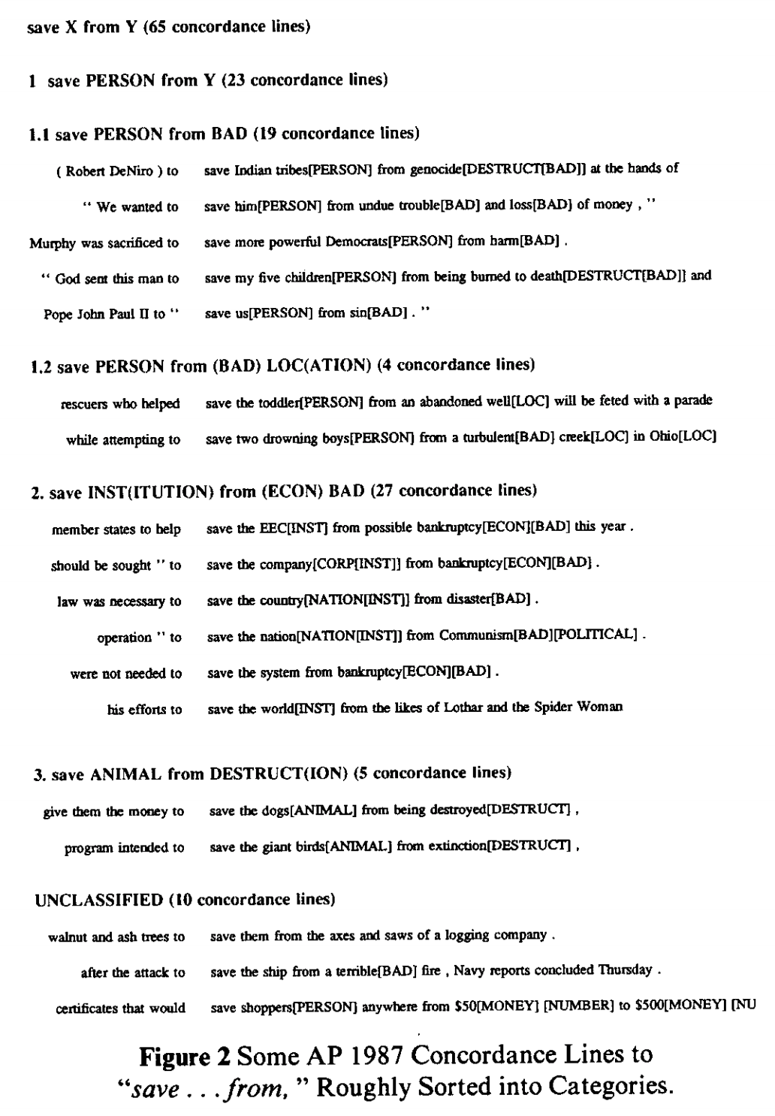
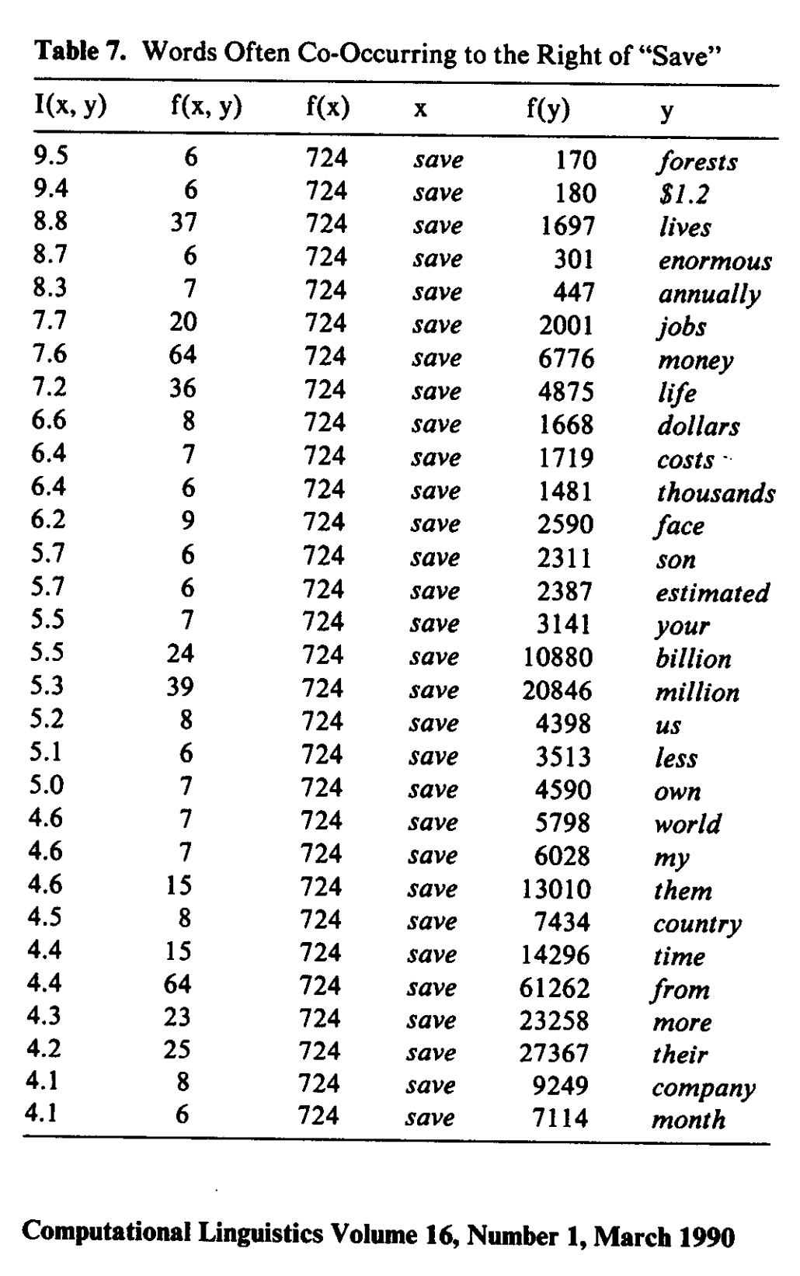
Save <good> from <bad>

Slide 50
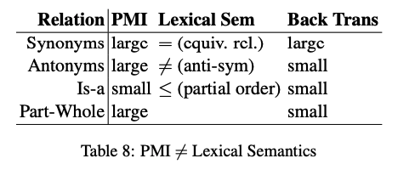
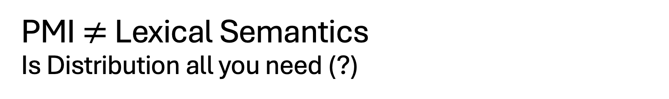

PMI $≠$ Lexical Semantics Is Distribution all you need (?)
Lexical Semantics
Synonyms: $x=y$
Antonyms: $x≠y$
Hypernyms (is-a): $x<y$
a car is a vehicle
PMI estimates collocations
Probability that two words
appear near one another,
normalized by chance
good / OK / bad
Large PMI
Collocations:
Truth, Justice & American Way
Red, White and Blue
Synonyms: true / correct
Antonyms: true / false
Part-Whole: window /house

Slide 51
Agenda
Bots
Predictability
PMI & Lexicography
Lexical Semantics: With and Without Embeddings
PMI: Pointwise Mutual Information
PMI → Word2Vec → Bots

Slide 52

Semantics → Embeddings PMI → Word2Vec → Bots
Lexical Semantics
Synonyms: $x=y$
Antonyms: $x≠y$
Hypernyms (is-a): $x<y$
a car is a vehicle
Vectors/Embeddings:
More modern view of meaning
Behind much of the recent excitement in AI
Large Language Models (LLM)
Bots: ChatGPT, DeepSeek
Equivalence Relation
Partial Order

Slide 53
We define meaning of a word as a vector
Jurafsky’s Slide 29
Called an "embedding" because it's embedded into a space (see textbook)
The standard way to represent meaning in NLP
Every modern NLP algorithm uses embeddings as the representation of word meaning
Fine-grained model of meaning for similarity

Slide 54
Defining meaning as a point in space based on distribution
Each word = a vector (not just "good" or "w₄₅")
Similar words are "nearby in semantic space"
We build this space automatically by seeing which words are nearby in text
Jurafsky’s Slide
Notes:
In vector semantics, we define meaning as a point in space based on distribution. Each word is a vector, not just a string like "good" or an index like "w_45". Similar words are nearby in semantic space, and, crucially, as we'll see, we build this space automatically by seeing which words are nearby in text. Here we see shows a visualization of embeddings learned for sentiment analysis, showing the location of selected words projected down from 60-dimensional space into a two dimensional space. Notice the distinct regions containing positive words, negative words, and neutral function words.

Slide 55
Simple static embeddings you can download!
Jurafsky’s Slide 63
Word2vec (Mikolov et al)
https://code.google.com/archive/p/word2vec/
GloVe (Pennington, Socher, Manning)
http://nlp.stanford.edu/projects/glove/

Slide 56




PMI → Word2Vec → Doc2Vec (BERT)
Word2Vec:
words → vectors
$Z∈ℛ^{v×d}$
$v$: # of words in vocabulary
$d$: # of hidden (latent) dimensions
Doc2Vec
doc → vectors
$Z∈ℛ^{n×d}$
$n$: # of docs in collection
https://huggingface.co/google-bert/bert-base-uncased

Slide 57

Code for running BERT (and more)
HuggingFace embeddings:
texts + model → vectors
$Z∈ℛ^{n×d}$
$n$: # of input texts
https://github.com/kwchurch/JSALT_Better_Together/blob/main/src/make_HF_embeddings.py
https://huggingface.co/google-bert/bert-base-uncased

Slide 58



Word2Vec
Vector Semantics
Linguistic generalizations
Word associations (dist in plot)
Features (red line)
Countries & Capitals
Analogies:
Man : Woman :: King : x
x → queen
Athens : Greece :: Bangkok: x
x → Thailand
https://code.google.com/archive/p/word2vec/

Slide 59


man : woman :: king : x
Vector addition & subtraction
$vec\left(king+woman −man\right)=vec\left(king\right)+vec\left(woman\right)−vec(man)$
Analogies
$\hat{x}=\underset{x∈V}{ARGMAX}{sim(x, king+woman −man)}$
Near misses

Slide 60
Agenda
Bots
Predictability
PMI & Lexicography
Lexical Semantics: With and Without Embeddings
PMI: Pointwise Mutual Information
PMI → Word2Vec → Bots
SVD & Term by Document Matrix

Slide 61
From PMI to Bots Connecting the dots between the past and the future
PMI → Word2Vec → Bots
PMI (Past): Pointwise Mutual Information
Original Motivation for PMI:
Help Lexicographers to find interesting “collocations”
Word2Vec: factored representation of PMI
Bots (Future): Word2Vec → Doc2Vec
Embeddings: Represent “everything” as vectors
Everything:
Words (in all languages)
Documents (in all languages)
Multi-modal: Text, Speech, Pictures, Videos
Answer all questions by table lookup (cosine similarity of vectors)

Slide 62
Dimension Reduction
Visualization
Need to map vectors
from many dimensions
down to 2D
Word2Vec
Each word is a vector of hundreds of numbers
How did they plot them in 2D?

Slide 63


https://en.wikipedia.org/wiki/Multidimensional_scaling
Method
An example of classical multidimensional scaling applied to voting patterns in the United States House of Representatives. Each blue dot represents one Democratic member of the House, and each red dot one Republican.
Input:
Table $Z∈ℝ^{c×b}$ of
Rows: Congressmen: $c$
Cols: Votes on bills: $b$
Compute Similarities
Cosines
$S_{1}=ZZ^{T}$ $∈ℝ^{c×c}$
$S_{2}=Z^{T}Z$ $∈ℝ^{b×b}$
Dimension Reduction:
$Z∈ℝ^{c×b}$→ $Z∈ℝ^{c×2}$
PCA: Principal Component Analysis
SVD: Singular Value Decomposition
By Andrewman327 - Own work, CC BY 3.0, https://commons.wikimedia.org/w/index.php?curid=27273909

Slide 64

Singular Value Decomposition (SVD)
$Z=UDV^{T}$
Python
U,D,Vt = np.linalg.svd(Z)
Zhat = U @ np.diag(D) @ Vt
To reduce dimensions to 2D
D[2:] = 0
Plot U[0,:] vs. U[1,:]
Often useful to scale by $\sqrt{D}$

Slide 65

PMI: Factored Version of Word2Vec
Let $S$ be a PMI similarity matrix
where $S∈ℛ^{v×v}$
$S$ is symmetric
$v$: # of words in vocabulary
Since $S$ is too large to materialize,
use SVD to factor $S$ as $S$ $≈Z Z^{T}$
That is, $if S=UDV^{T}$, then $Z=U\sqrt{D}$
Set the smaller singular values to 0
so we can afford to materialize $Z$.
Rows of $Z$can be interpreted as Word2Vec vectors

Slide 66

Inference (Table Lookup): Database + Query → Answers
Approximate nearest neighbors (ANN)
Input:
database ($Z$) +
query (vector)
Output:
short list of answers
(vectors in$Z$near query)
Example:
Thesaurus Questions
What are some synonyms for “good”?

Slide 67

Inference (Table Lookup): Database + Query → Answers
Approximate nearest neighbors (ANN)
Input: database ($Z$) + query (vector)
Output: short list of answers (vectors in database near query)
Example: Thesaurus Questions
What are some synonyms for “good”?
Bots answer most questions by ANN (table lookup)
Without (much) GOFAI (good old-fashioned Artificial Intelligence)
https://en.wikipedia.org/wiki/GOFAI
Reasoning, representation, rationalism
On the Dangers of Stochastic Parrots:
Can Language Models Be Too Big? 🦜

Slide 68
Conclusions
Agenda
Take-Away Messages
Bots
Predictability
PMI & Lexicography
Lexical Semantics: With and Without Embeddings
PMI: Pointwise Mutual Information
PMI → Word2Vec → Bots
Bots are not (necessarily) cheating
Please take advantage of opportunities (in responsible ways)
Predictability
Opportunities: people & machines
Useful techniques:
Represent everything as vectors
Similarity: Cosines on Vectors
Singular Value Decomposition (SVD):
Dimension Reduction
Visualization

Slide 69
CogSci: Interdisciplinary
Word Associations
Psychology
Psycholinguistics
Humanities
Linguistics
Syntax, Semantics, Phonology & Phonetics
Lexicography: Corpus-based methods
Translation
Education:
Testing (Vocabulary Size)
Math
Statistics & Linear Algebra
Engineering
Information Theory, Artificial Intelligence (AI), Machine Learning (ML), Computational Linguistics (CL), Machine Translation (MT), Information Retrieval (IR), Speech & Vision
Mutual Information
Connect Three Dots

Slide 70
Backup

Slide 71
Agenda
Bots
Predictability
PMI & Lexicography
Lexical Semantics: With and Without Embeddings
PMI: Pointwise Mutual Information
PMI → Word2Vec → Bots
SVD & Term by Document Matrix

Slide 72



SVD: Singular Value Decomposition
 | c1 | c2 | c3 | c4 | c5 | m1 | m2 | m3 | m4
human | 1 | 0 | 0 | 1 | 0 | 0 | 0 | 0 | 0
interface | 1 | 0 | 1 | 0 | 0 | 0 | 0 | 0 | 0
computer | 1 | 1 | 0 | 0 | 0 | 0 | 0 | 0 | 0
user | 0 | 1 | 1 | 0 | 1 | 0 | 0 | 0 | 0
system | 0 | 1 | 1 | 2 | 0 | 0 | 0 | 0 | 0
response | 0 | 1 | 0 | 0 | 1 | 0 | 0 | 0 | 0
time | 0 | 1 | 0 | 0 | 1 | 0 | 0 | 0 | 0
EPS | 0 | 0 | 1 | 1 | 0 | 0 | 0 | 0 | 0
survey | 0 | 1 | 0 | 0 | 0 | 0 | 0 | 0 | 1
trees | 0 | 0 | 0 | 0 | 0 | 1 | 1 | 1 | 0
graph | 0 | 0 | 0 | 0 | 0 | 0 | 1 | 1 | 1
minors | 0 | 0 | 0 | 0 | 0 | 0 | 0 | 1 | 1
M: term by doc matrix
$M≈UDV^{T}$
U,D,Vt = np.linalg.svd(M)
D: Singular Values
$UU^{T}=I;VV^{T}=I;$
$\hat{M}=U@\text{np}\text{.}\text{diag}(D)@V^{T}$
Dimension reduction
D[2:]=0
$\hat{M}=U@\text{np}\text{.}\text{diag}(D)@V^{T}$

Slide 73



Dimension Reduction → Visualization

Slide 74


plot(hclust(as.dist(1-cor(m)))
 | c1 | c2 | c3 | c4 | c5 | m1 | m2 | m3 | m4
human | 1 | 0 | 0 | 1 | 0 | 0 | 0 | 0 | 0
interface | 1 | 0 | 1 | 0 | 0 | 0 | 0 | 0 | 0
computer | 1 | 1 | 0 | 0 | 0 | 0 | 0 | 0 | 0
user | 0 | 1 | 1 | 0 | 1 | 0 | 0 | 0 | 0
system | 0 | 1 | 1 | 2 | 0 | 0 | 0 | 0 | 0
response | 0 | 1 | 0 | 0 | 1 | 0 | 0 | 0 | 0
time | 0 | 1 | 0 | 0 | 1 | 0 | 0 | 0 | 0
EPS | 0 | 0 | 1 | 1 | 0 | 0 | 0 | 0 | 0
survey | 0 | 1 | 0 | 0 | 0 | 0 | 0 | 0 | 1
trees | 0 | 0 | 0 | 0 | 0 | 1 | 1 | 1 | 0
graph | 0 | 0 | 0 | 0 | 0 | 0 | 1 | 1 | 1
minors | 0 | 0 | 0 | 0 | 0 | 0 | 0 | 1 | 1

Slide 75

plot(hclust(as.dist(1-cor(t(m))))
 | c1 | c2 | c3 | c4 | c5 | m1 | m2 | m3 | m4
human | 1 | 0 | 0 | 1 | 0 | 0 | 0 | 0 | 0
interface | 1 | 0 | 1 | 0 | 0 | 0 | 0 | 0 | 0
computer | 1 | 1 | 0 | 0 | 0 | 0 | 0 | 0 | 0
user | 0 | 1 | 1 | 0 | 1 | 0 | 0 | 0 | 0
system | 0 | 1 | 1 | 2 | 0 | 0 | 0 | 0 | 0
response | 0 | 1 | 0 | 0 | 1 | 0 | 0 | 0 | 0
time | 0 | 1 | 0 | 0 | 1 | 0 | 0 | 0 | 0
EPS | 0 | 0 | 1 | 1 | 0 | 0 | 0 | 0 | 0
survey | 0 | 1 | 0 | 0 | 0 | 0 | 0 | 0 | 1
trees | 0 | 0 | 0 | 0 | 0 | 1 | 1 | 1 | 0
graph | 0 | 0 | 0 | 0 | 0 | 0 | 1 | 1 | 1
minors | 0 | 0 | 0 | 0 | 0 | 0 | 0 | 1 | 1

Slide 76


Similarity Matrix (S) → Embedding (Z)
Similarity of columns
Similarity of rows
$\hat{M}=UDV^{T}$
$S_{1} = M M^{T}$
$S_{1}≈Z Z^{T}$
where $Z=U D$
Embedding
$Z∈ℛ^{n×d}$
$n$: rows of $\hat{M}$ (# of docs)
$d$: hidden (latent) dimensions
dimension reduction: $d≪n$
$\hat{M}=UDV^{T}$
${\hat{M}}^{T}$=$VDU^{T}$
$S_{2} = M^{T}M$
$S_{2}≈Z Z^{T}$
where $Z=V D$
Embedding
$Z∈ℛ^{n×d}$
$n$: columns of $\hat{M}$ (# of words in vocab)
$d$: hidden (latent) dimensions
dimension reduction: $d≪n$

Slide 77
Brown Corpus: Influential over many fields
Brown Corpus: widely cited over many fields:
Information Retrieval
Baeza-Yates and Ribeiro-Neto (1999)
Lexicography
Miller (1995)
Sociolinguistics
Biber (1991)
Psychology
MacWhinney (2000)
Computational Linguistics
Marcus et al (1993)
Jurafsky and Martin (2000)
Church and Hanks (1990)
Resnik (1995)
6/27/2014
Fillmore Workshop
77

Slide 78
Brown Corpus is a Balanced Corpus (Unlike many recent catch-as-catch-can corpora)
A sample of 1M words
Contemporary (1960s)
American English
Statified over 15 genres (A-R)
500 documents
2000 words each
Many subsequent corpora
British National Corpus (BNC)
British (as opposed to American)
Larger: 1M words → 100M words
More recent (1990s v. 1960s)
15 Genres: A-R (500 documents)
Press: A (44) reportage, B (27) editorial, C (17) reviews
Religion: D (17)
Skills and hobbies: E (36)
Popular lore: F (48)
Belle-letters: G (75)
Misc: H (30): gov docs, foundation reports, industry reports, college catalog
Learned: J (80): science, medicine, math, social science, humanities, engineering
Fiction: K (29) general, L (24) mystery, M (6) science fiction, N (29) Westerns, P (29) romance, R (9) humor
There is no data like more data
6/27/2014
Fillmore Workshop
78

Slide 79
Freq depends on genre
and other factors

Slide 80
Predictable contexts
Easier for people
Subjects respond quicker and more accurately
when contexts are predictable
Also, easier for machines
Web search
Bots
Information Retrieval
Speech recognition
Vision
Predictability varies over many factors: genre, time, space, etc.

Slide 81
Google Ngrams for “Kennedy” Books published since 1500
Brown Corpus
WW II
Frequency depends on time

Slide 82
Google Trends for “Kennedy”: Queries over 12 months (7/24-7/25)
Election

Slide 83

Zipf’s Law: $freq ∝\frac{1}{rank}$
More predictable
Function words: the, of, and
Very predictable
Content words: quality
Less predictable
Frequency effect:
higher freq →
faster reaction times (RT)
Less predictable
Figure from Shannon’s paper on entropy of English

Slide 84


Zipf’s Law: $freq ∝\frac{1}{rank}$
Zipf’s Law is a rule of thumb,
but probabilities need to sum to 1
and $\sum_{r=1}^{∞}{\frac{1}{r}}$ doesn’t converge
High freq: function words ($T≈{10}^{−3}$)
Low freq: content words ($T≈{10}^{−6}$)
Frequency effect: higher freq → faster reaction times (RT)
Content Words
$$\operatorname{Pr}\left(x\right)<T$$
Figure from Shannon’s paper on entropy of English

Slide 85





Special Issue of International Journal of Lexicography in Memory of Patrick Hanks

Slide 86
Agenda
Bigger Picture: A personal perspective not found in textbooks
Corpora
Lexical Semantics
Word Associations
Information Theory
PMI → Word2Vec → Bots

Slide 87


A Pendulum Swung Too Far Church, K. 2011. A Pendulum Swung Too Far. Linguistic Issues in Language Technology
1950s: Empiricism
(Shannon, Skinner, Firth, Harris)
1970s: Rationalism
(Chomsky, Minsky)
1990s: Revival of empiricism
(IBM, AT&T Bell Labs)
2010s: Revival of rationalism (?)
Extreme empiricism
(LLMs, ChatGPT & DeepSeek)
Students rebel every twenty years
Grandparents & Grandchildren

Slide 88

Cognitive Science in 1950s at Harvard (and later MIT & Brown)
CogSci
George Miller (CogSci)
Noam Chomsky (Linguistics)
Marvin Minsky (AI)
CogSci: Reaction to
Information Theory (Bell Labs → MIT)
Behaviorism
BF Skinner
My father (Russell Church)
Q: Have I been in a Skinner box?
A: Yes
Empiricism
Zipf
By Original: AndreasJS Vector: Pixelsquid - This file was derived from: Skinner box scheme 01.png: by AndreasJS, CC BY-SA 3.0, https://commons.wikimedia.org/w/index.php?curid=99322433

Slide 89



Slide 90


Slide 91
Agenda
Bigger Picture: A personal perspective not found in textbooks
Corpora
Lexical Semantics
Word Associations
Information Theory
PMI → Word2Vec → Bots

Slide 92

Statistics: Combining Models with Observations
Models (from Probability)
Binomial
Multinomial
Normal
Poisson
Exponential
Observations: Corpora
Assumptions: IID
https://en.wikipedia.org/wiki/Independent_and_identically_distributed_random_variables
Example:
What is the probability of finding
exactly $k$ instances of “Kennedy”
in a sample of $n$ words?
Model: binomial
$Pr⁡(k) = \left(\begin{matrix}n \\ k\end{matrix}\right)p^{k}q^{n−k}$
Observations: Brown Corpus
Sample size: $N =$ 1M words
freq(“Kennedy”) $=104$
Fitting the model
$p=104/{10}^{6}≈{10}^{−4}$
$q=1−p$
Challenge(s): IID assumption
“Kennedy” is more frequent
in news in 1960s than religion

Slide 93
Freq depends on many factors, e.g, genre, time

Slide 94
Freq depends on news type (reportage vs. editorial)

Slide 95
Priming & Self-Priming (Burstiness) Predictability is easier than randomness
First order effect
Word Frequency (Zipf’s Law is easier than uniform)
Second order effect(s)
Priming: doctor → nurse (easier than independence)
Self-priming (Burstiness/Contagiousness):
If Kennedy is mentioned once in a doc,
expect a subsequent mention
Easier than Poisson

Slide 96
Agenda
Bigger Picture: A personal perspective not found in textbooks
Corpora
Lexical Semantics
Word Associations
Information Theory
PMI → Word2Vec → Bots

Slide 97

So far
Jurafsky’s Slide 17
Word-Sense Disambiguation (WSD)
Concepts or word senses
Have a complex many-to-many association with words (homonymy, multiple senses)
Have relations with each other
Synonymy
Antonymy
Similarity
Relatedness
Connotation
Collocations
Collocations
Collocations
Collocations
Collocations
Large PMI
https://web.stanford.edu/~jurafsky/slp3/slides/vectorsemantics2024.pdf

Slide 98

PMI $≠$ Lexical Semantics $≠$ Back Translation
PMI estimates collocations
Probability that two words
appear near one another,
normalized by chance
good / OK / bad
Back Translation
Random walk over translations
Good → Bien → OK
But not, good → … → bad
Large PMI
Collocations:
Truth, Justice & American Way
Red, White and Blue
Synonyms: true / correct
Antonyms: true / false
Part-Whole: window /house

Slide 99
Agenda
Bigger Picture: A personal perspective not found in textbooks
Corpora
Lexical Semantics
Word Associations
Information Theory
PMI → Word2Vec → Bots

Slide 100
Agenda
Bigger Picture: A personal perspective not found in textbooks
Corpora
Lexical Semantics
Word Associations
Information Theory
PMI → Word2Vec → Bots

Slide 101

Pointwise Mutual Information (PMI)
Entropy:
$H\left(X\right)=−\sum_{x∈X}{p\left(x\right)\log_{2}}p\left(x\right)$
Mutual Information
$I\left(X;Y\right)=H\left(X\right)−H\left(X | Y\right)$
$I\left(Y;X\right)=H\left(Y\right)−H(Y|X)$
Properties:
Symmetry $I\left(X;Y\right)=I(Y;X)$
Non-negative: $I(X;Y)≥0$
Pointwise

Slide 102


Pointwise Mutual Information (PMI)
PMI has a simple interpretation
PMI compares P(x,y) with chance
Chance = P(x) P(y)
If there is a genuine association
then P(x,y) >> P(x) P(y)
Uninteresting associations
P(x,y) ≈ P(x) P(y)
Entropy:
$H\left(X\right)=−\sum_{x∈X}{p\left(x\right)\log_{2}}p\left(x\right)$
Mutual Information
$I\left(X;Y\right)=H\left(X\right)−H\left(X | Y\right)$
$I\left(X;Y\right)=H\left(Y\right)−H(Y|X)$
Properties:
Symmetry $I\left(X;Y\right)=I(Y;X)$
Non-negative: $I(X;Y)≥0$
Pointwise

Slide 103



Slide 104



Telephone
$$X$$
$$Y$$

Slide 105

Telephone
Gzip
Encoder
Decoder
Perception
Production

Slide 106


Slide 107

Perplexity & Entropy
Lexical Retrieval
Perplexity $2^{H(x)}$: Summary of number of guesses
Entropy $H\left(x\right)$: Number of bits required to store $x$
Bandwidth of a communication channel
$H\left(X\right)=−\sum{p\log_{2} p}$
Gzip

Slide 108
Agenda
Bigger Picture: A personal perspective not found in textbooks
Corpora
Lexical Semantics
Word Associations
Information Theory
PMI → Word2Vec → Bots

Slide 109

PMI → Word2Vec
Word2Vec: Represent words as vectors
Embed words in a vector space
$sim(x,y) ≈ cos⁡(x,y)$
Dimension Reduction
Singular Value Decomposition (SVD)
Connect the dots with PMI
Motivation for embeddings
Visualization
Semantic types: cities vs. countries
Analogies

Slide 110
Conclusions
Bigger Picture: A personal perspective not found in textbooks
Corpora
Lexical Semantics
Word Associations
Information Theory
PMI → Word2Vec → Bots

Slide 111

Some analogies are easier than others
Tweets
RT @tallinzen: sure, king:queen etc, but did you know word2vec gets real SAT analogies right just 1% of the time?
15 copies of this tweet
Some by NLP experts
Resources Debate
WordNet &
British National Corpora

Slide 112

Levy & Goldberg (NIPS-2014) Word2Vec ≈ PMI (Pointwise Mutual Info)
Levy & Goldberg (NIPS-2014) is a theoretical arg
Plots → correlations are large, but far from perfect
Materials:
N = 22 words (11 cities + 11 countries)
N (N-1)/2 = 231 pairs of words (points)
type in {city, country}
Color:
Green → type match
Red → type mismatch

Slide 113

Zipf’s Law: $freq \sim \frac{1}{rank}$
Function Words
Non-uniform probabilities → Opportunities for compression
Content Words

Slide 114
Thinking Fast and Slow Quoted from pp. 20-21
System 1 operates automatically and quickly,
with little or no effort and
no sense of voluntary control.
System 2 allocates attention to the effortful mental activities that demand it, including complex computations.
The operations of System 2 are often associated with the subjective experience of agency, choice, and concentration.

Slide 115


Probability Theory
Urn Models
Events:
A corpus: a sample of a population
Picking next word is like a coin toss
Let $p$ be the probability of heads
The next word is “Kennedy”
Let $q$ be the probability of tails
where $p+q=1$
${\left(p+q\right)}^{n}=\sum_{k=0}^{k=n}{\left(\begin{matrix}n \\ k\end{matrix}\right)}p^{k}q^{n−k}$
What is the probability of
exactly $k$ instances of “Kennedy”
in a sample of $n$ words
Binomial is one of many models
Binomial: Logistic Regression
Multinomial: Softmax

Slide 116
Connecting Dots
CogSci: Interdisciplinary
Past, Present and Future
Where have we been and where are we going?
Word Associations
Psychology
Psycholinguistics
Humanities
Linguistics
Syntax, Semantics, Phonology & Phonetics
Lexicography: Corpus-based methods
Translation
Education:
Testing (Vocabulary Size)
Math
Statistics & Linear Algebra
Engineering
Information Theory, Artificial Intelligence (AI), Machine Learning (ML), Computational Linguistics (CL), Machine Translation (MT), Information Retrieval (IR), Speech & Vision
Past: PMI
Present
Future: Bots
Mutual Information
Connect Three Dots

